Slide 1

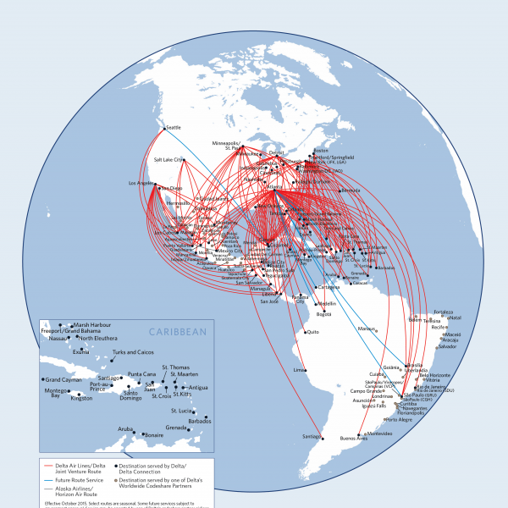
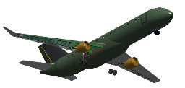
IT-500 TESE Project Status “Integrated Aircraft Design and Air Transport Network Optimization”
PhD Candidate: José Alexandre Tavares Guerreiro Fregnani
Advisors: Prof. Bento da Silva Mattos / Prof. José Antônio Hernandes
13-01-2019
Notes:
Este modelo pode ser usado como arquivo de partida para apresentar materiais de treinamento em um cenário em grupo.
Seções
Clique com o botão direito em um slide para adicionar seções. Seções podem ajudar a organizar slides ou a facilitar a colaboração entre vários autores.
Anotações
Use a seção Anotações para anotações da apresentação ou para fornecer detalhes adicionais ao público. Exiba essas anotações no Modo de Exibição de Apresentação durante a sua apresentação.
Considere o tamanho da fonte (importante para acessibilidade, visibilidade, gravação em vídeo e produção online)
Cores coordenadas
Preste atenção especial aos gráficos, tabelas e caixas de texto.
Leve em consideração que os participantes irão imprimir em preto-e-branco ou escala de cinza. Execute uma impressão de teste para ter certeza de que as suas cores irão funcionar quando forem impressas em preto-e-branco puros e escala de cinza.
Elementos gráficos, tabelas e gráficos
Mantenha a simplicidade: se possível, use estilos e cores consistentes e não confusos.
Rotule todos os gráficos e tabelas.

Slide 2

Content
Introduction
Motivation
Objectives
Project Schedule
Literature Review
Methodology
Study Cases
Final Remarks
Next Steps
Notes:
Forneça uma breve visão geral da apresentação. Descreva o foco principal da apresentação e por que ela é importante.
Introduza cada um dos principais tópicos.
Para fornecer um roteiro para o público, você pode repita este slide de Visão Geral por toda a apresentação, realçando o tópico específico que você discutirá em seguida.

Slide 3

Introduction
The conceptual design of airliners is usually carried out by OEMs (and academia) through the optimization of averaged direct operational cost (DOC) for a given set of stage lengths (range), chosen by the project teams;
During this phase an usual approach is to conduct surveys with airlines to incorporate their requirements into the project:
A common practice is to allocate airline representatives into an aircraft development program council.
Different airlines present different requirements for their fleets, highly influenced by their destinations and business profile:
Studies on transport networks are carried out by airlines considering specific business objectives - sometimes not directly explicit to OEM teams.

Slide 4
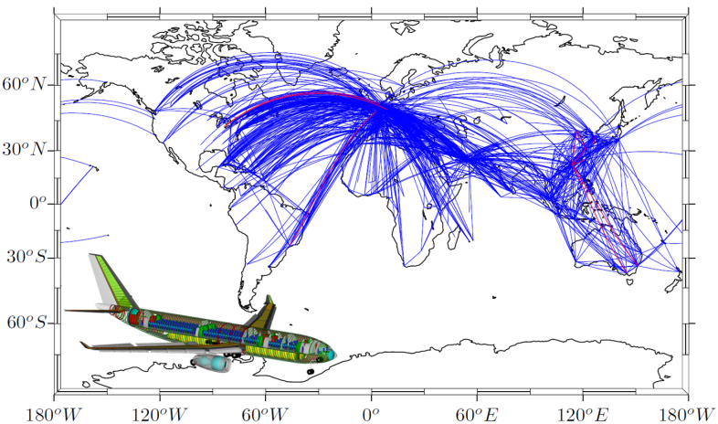
Introduction
Some of the tools used in aircraft design in the conceptual phase are limited, adopting simplistic models in the aeronautical disciplines, and therefore lower fidelity, in the sake of computational costs;
Aircraft designers most of the times simplify mission requirements and perform optimizations focused on subsystems, not envisioning the high degree of dependency that exists between airplane and network, resulting on a sub-optimization systems functionalities;

Slide 5
Introduction – Some aspects to consider
Objectives vs. Aircraft Parameters
Passenger Comfort
+
Field Performance
+
Range
+
Remained requirements
Best valued product for the market
DOC

Slide 6
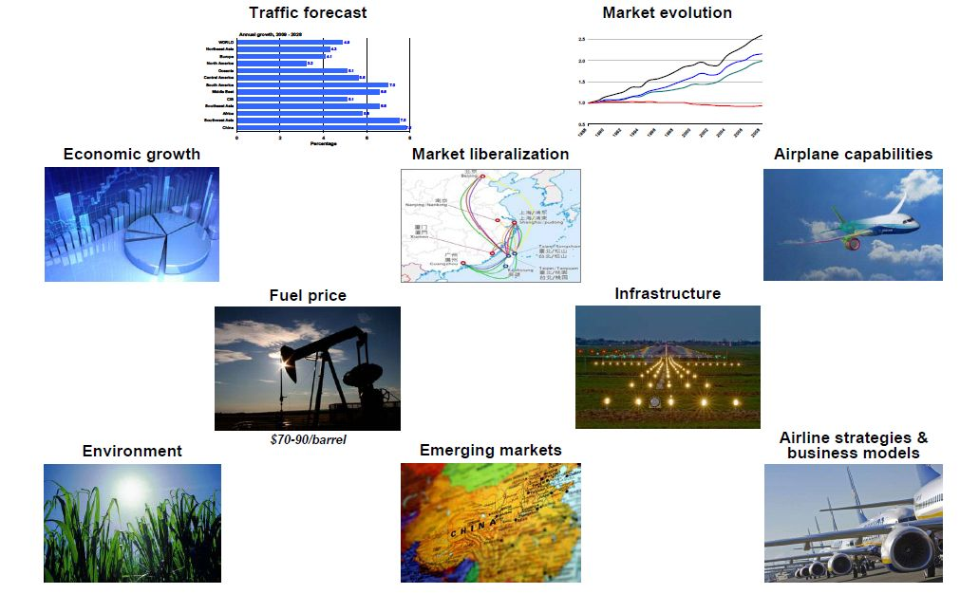
Introduction – Some aspects to consider
Market Drivers

Slide 7
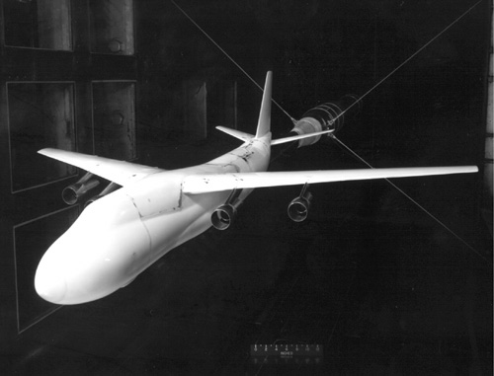
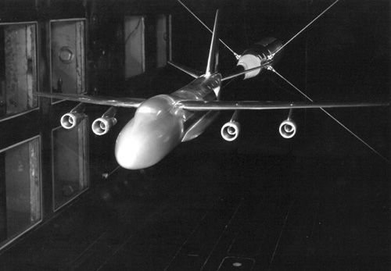
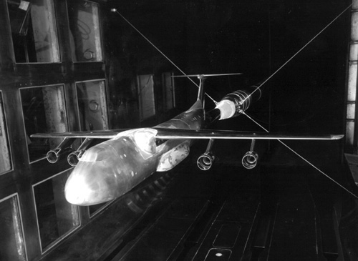
Introduction – Some aspects to consider
Configurations
Competing C-5 configurations during tests in the Langley 8-Foot Transonic Pressure Tunnel.
Boeing concept
Douglas concept
Lockheed concept

Slide 8
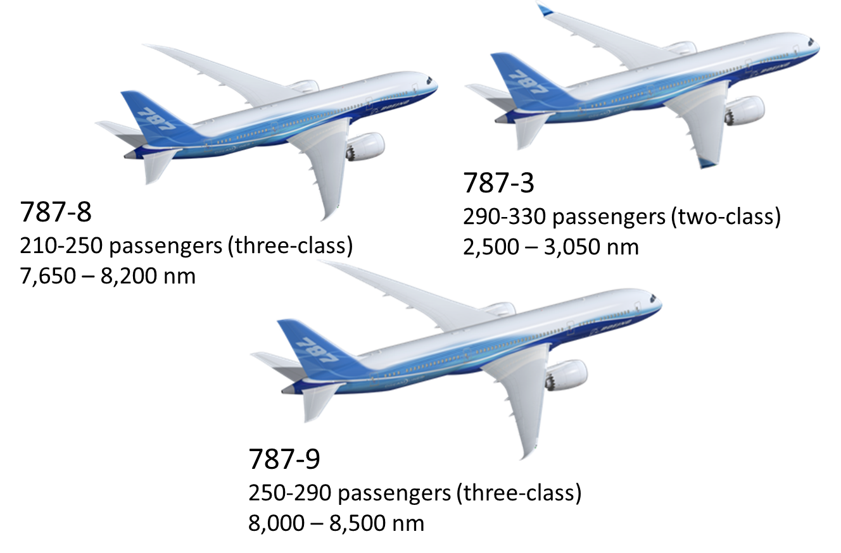
Introduction – Some aspects to consider
Family of Aircraft

Slide 9
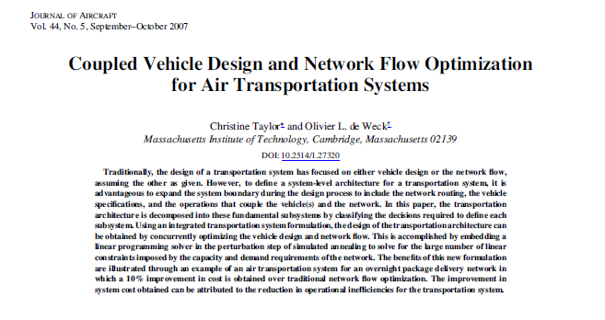
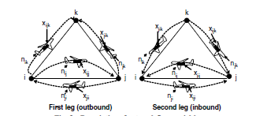
Motivation
Christine Taylor and Olivier De Weck. "Coupled Vehicle Design and Network Flow Optimization for Air Transportation Systems", Journal of Aircraft, Vol. 44, No. 5 (2007), pp. 1479-1486.
Hub and Spoke Network formulation (no Intermediate stops);
Simple route connections (Great Circle distance);
Cargo Airline (payload optimization);
Very simplistic Performance Model (Breguet Range Equation to estimate fuel consumption);
3 Aircraft “Design” Parameters: Range, L/D and Cruise Speed;
Minimization of System’s DOC only;
Uses Simulated Annealing Algorithm.

Slide 10
Motivation
Is it possible to
optimize the complete system, aircraft and network at once, in a detailed and effective manner,
thus
optimizing the aircraft or group of aircraft that can operate inside a typical network of major airline ?

Slide 11
Research Objectives
The main goal of this research project is the development of a Multidisciplinary Design Optimization (MDO) framework that incorporates a highly detailed airplane model and optimization of airline networks.
Under this scope the following achievements are envisioned:
Development of an innovative airplane calculator for conceptual design considering:
Preliminary structural sizing;
Enhanced tail sizing, CG estimation and Landing Gear sizing methods;
Certification design envelope limitations;
Use of Artificial Neural Network (ANN) for the calculation of the drag polar (including in the transonic regime) ;
Use of realistic turbofan engine thermodynamic model, including 3D compressor mapping;
Development of a Mission Analysis Module, considering optimum performance profile, realistic dispatch requirements and airspace/airport characteristics;
Design of optimal airplane that fits into a fixed airline network and given passenger demand;
Design of optimal airline network for a desired or given fleet of airplanes , based on a appropriate passenger demand model;
Integrated optimal design of network and airplane;

Slide 12
Project Schedule

Slide 13
Project Schedule - Publications
Journals
Published:
Fregnani, J.A.T.G. and Mattos, B.S. (2017). “AN EXAMPLE OF GENETIC ALGORITHMS APPLIED TO MULTIDISCIPLINARY DESIGN OPTIMIZATION: THE 3D PAYLOAD-RANGE-DOC ENVELOPE” . Journal of Brazilian Air Transportation Society
Accepted (under edition):
Fregnani, J.A.G., Arantes, R.G. and Mattos, B.S. (2017). “THE IMPACT ON PRODUCTION AND COSTS AFTER THE ACQUISITION OF AN AIRLINE BY A COMPETITOR IN BRAZIL: A COBB-DOUGLAS FUNCTION APPLICATION” . Revista Transportes
In Progress:
Fregnani, J.A.T.G. , Mattos, B.S. and Hernandes, J.A. (2018). “An Innovative Approach for integrated Airline Network and Aircraft Family Optimization” . Chinese Journal of Aeronautics.
Mattos B.S., Fregnani, J.A.T.G. and Takashi, J. (2018). “The 1978 Airline Deregulation Act Effects on Aircraft Industry Measured by Entropy Statistics” . Revista Transports.
Book Chapters
B. S. Mattos, J. A. Fregnani e P. C. Magalhães.”Conceptual Design of Green Transport Airplane”., Book Series: Frontiers in Aerospace Science ed., vol. 3, Bentham Books, 2018.
Aviation and the Environment (CAP I)
An Innovative Approach for Optimal Airplane Design Encompassing an Airline Network - Pp. 324-375 (CAP.VII)
Flight Operations and Environment (CAP.VIII)
Symposiums
Fregnani, J.A.T.G. and Mattos, B. S. (2016). “Aviation and Electrical Road Vehicles”. In 16th AIAA Aviation Technology, Integration, and Operations Conference (p. 37-54).

Slide 14
LITERATURE REVIEW

Slide 15
Literature Review
100 bibliographical references were gathered and compiled since the beginning of the research (2Q 2015). To the best of our knowledge these publications provide a good insight under the problem into consideration, leading to the accomplishment of the first envisioned achievement addressed on the study plan.
All references were grouped into five different sections as follows:
Aircraft Design (23);
Multidisciplinary Design Optimization Frameworks (44);
Airline Network Design and Optimization (28);
Algorithms (5)
Lecture Notes (academic courses):
Multidisciplinary System Design Optimization (MIT, US);
Introduction to Multidisciplinary Design Optimization (Stanford Univ, US);
Design Optimization (Virginia Tech, US);
AA-265 Multiobjective Design Optimization (Technological Institute of Aeronautics, Brazil);

Slide 16
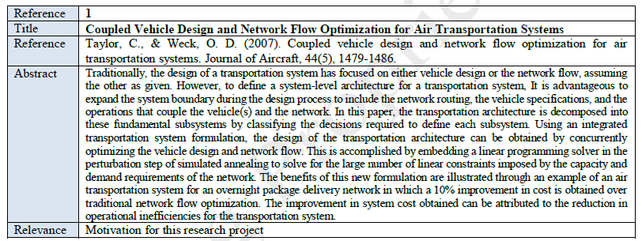
Literature Review - important references
Reference #2
Taylor, C. P. (2007). Integrated transportation system design optimization (Doctoral dissertation, Massachusetts Institute of Technology).
Hub and Spoke Network formulation (no Intermediate stops);
Simple route connections (Great Circle distance);
Cargo Airline (payload optimization);
Very simplistic Performance Model (Breguet Range Equation to estimate fuel consumption);
3 Aircraft “Design” Parameters: Range, L/D and Cruise Speed;
Minimization of System’s DOC only;
Uses Simulated Annealing Algorithm.

Slide 17
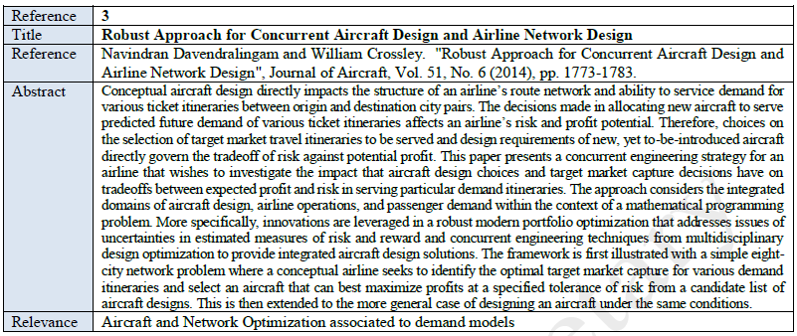
Literature Review - important references
Investigation of the impact of new aircraft on its optimal network;
Maximization of profit;
Candidate list of aircraft designs;
Study case for a network with 8 airports;
Linear programming model;
Risk tolerance;

Slide 18
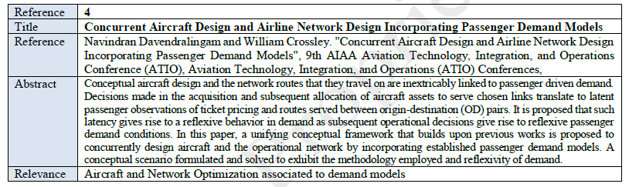
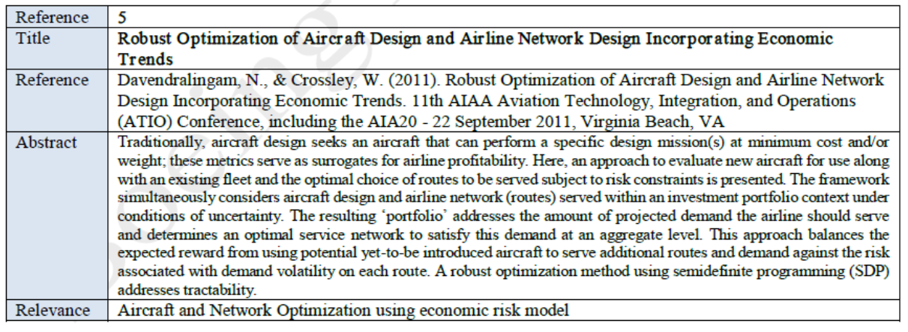
Literature Review - important references

Slide 19
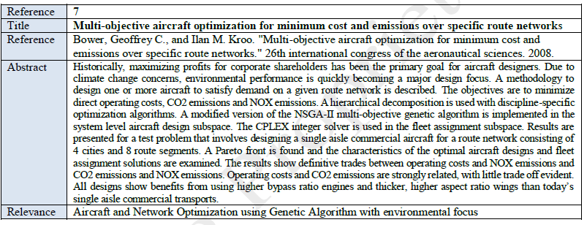
Literature Review - important references
Methodology for aircraft design considering demands of a given aerial network;
Objectives are the minimization of direct operating costs and airplane emissions;
Hierarchical decomposition was used with discipline-specific optimization algorithms using simplistic models;
A modified version of the NSGA-II multi-objective genetic algorithm;
The IBM ILOG CPLEX employed to solve fleet assignment subspace problems.

Slide 20
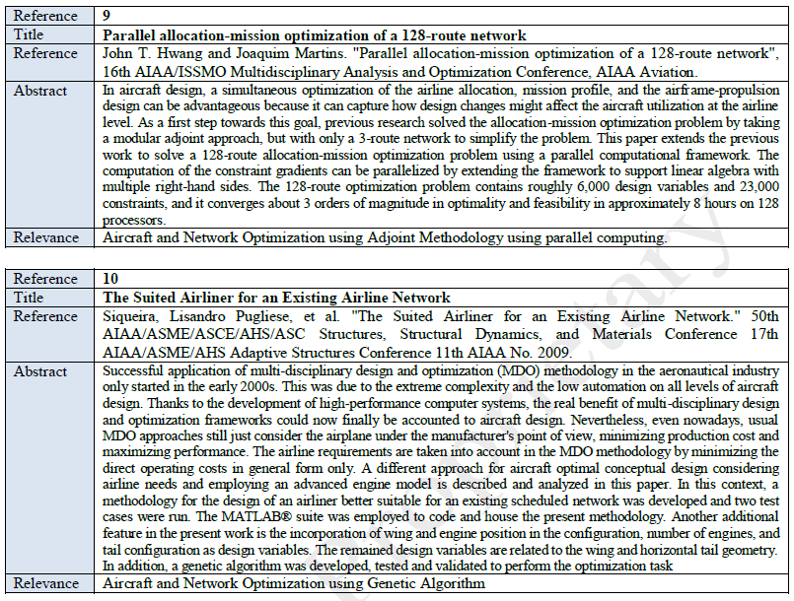
Literature Review - important references

Slide 21
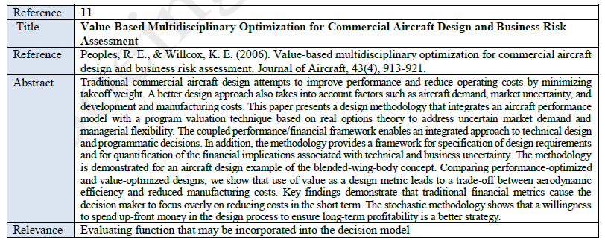
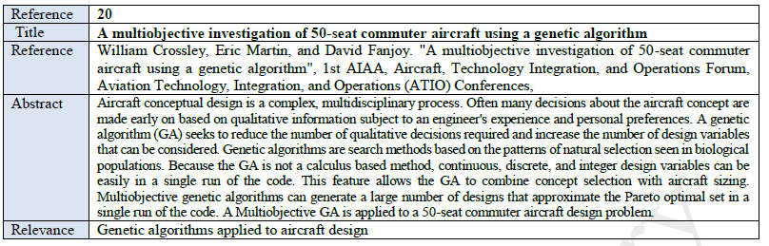
Literature Review - important references

Slide 22
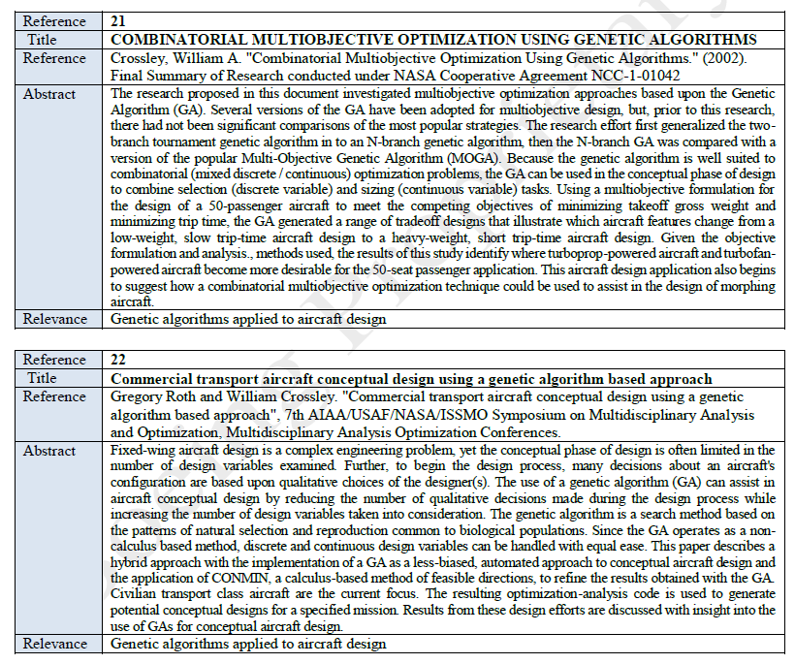
Literature Review - important references

Slide 23
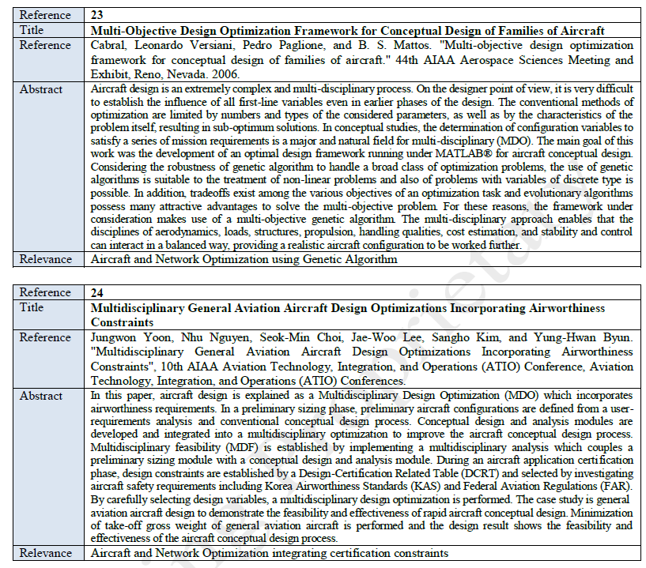
Literature Review - important references

Slide 24
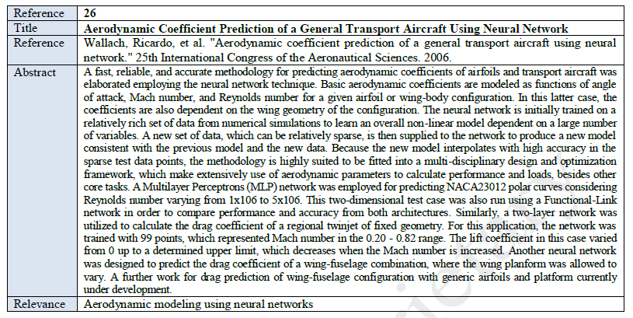
Literature Review - important references

Slide 25
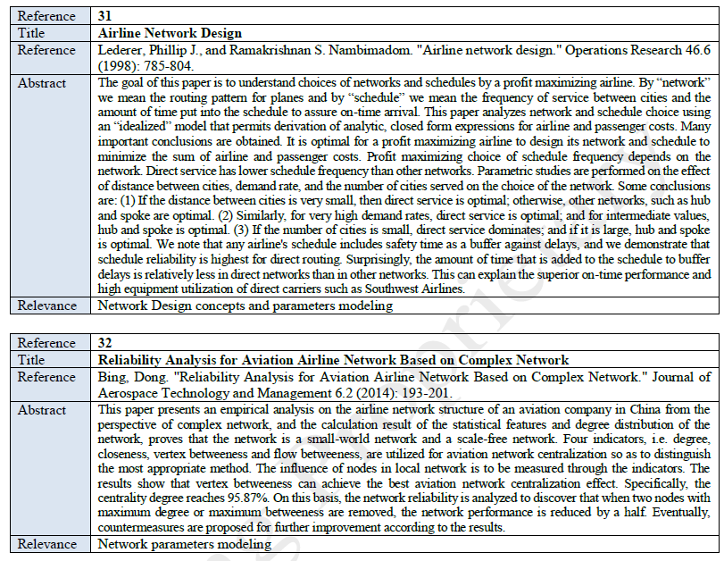
Literature Review - important references

Slide 26
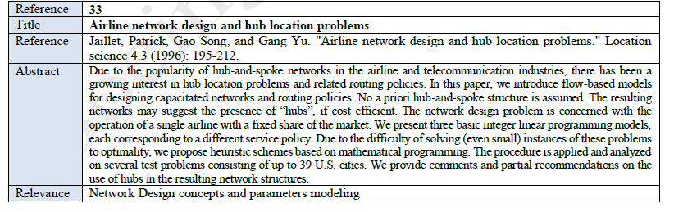
Literature Review - important references
Flow based model considering direct, one or two stops;
Minimization of Network DOC;
Inputs: demand flows (known), average DOC, airplane capacity and design ranges;
Outputs: route connections, possible hubs and frequencies (route assignment problem);
Study case for Single airline with certain market share in 39 US cities.

Slide 27
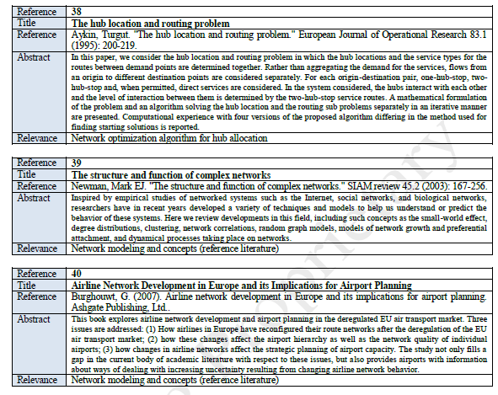
Literature Review - important references

Slide 28
Literature Review - important references
MOGA-II (Multiobjective Genetic Algorithm)
Fonseca,C.M and Fleming,P.J. (1993) Genetic Algorithms for Multiobjective Optimization: Formulation, Discussion and Generalization. Genetic Algorithms: Proceedings of the Fifth International Conference (S. Forrest, ed.), San Mateo, CA: Morgan Kaufmann, July 1993.
Uses a smart multi-search elitism for robustness and directional crossover for fast Pareto convergence.
Main features are:
Its efficiency is ruled by its operators (classical crossover, directional crossover, mutation and selection) and by the use of elitism.
Elitism = always favors individuals with better fitness value (rank).
Enforces user constraints by objective function penalization.
The direction of improvement is evaluated by comparing the fitness of the individual from generation t with the fitness of its parents belonging to generation t − 1.
The new individual is then created by moving in a randomly weighted direction that lies within the ones individuated by the given individual and his parents.
Allows concurrent evaluation of independent individuals.

Slide 29
Literature Review - important references
NSGA-II (Non-dominated Sorting Genetic Algorithm)
K. Deb, A. Pratap, S. Agarwal and T. Meyarivan, "A fast and elitist multiobjective genetic algorithm: NSGA-II," in IEEE Transactions on Evolutionary Computation”, vol. 6, no. 2, pp. 182-197, Apr 2002. doi: 10.1109/4235.996017
Fast and elitist multi-objective evolutionary algorithm.
Main features:
Allows continuous and binary-coded (discrete) variables.
A fast non-dominated sorting procedure is implemented.
Constraint handling does not make use of penalty parameters.
Modified elitism rule for multi-objective search.
A parameter-less diversity preservation mechanism is adopted.
Allows concurrent evaluation of n independent individuals (n = number of generations)

Slide 30
METHODOLOGY

Slide 31
Methodology
A full MDO framework is proposed to solve the complete optimization of the aircraft and network system in a multilevel-nested analysis design analysis (NAND) approach (Balling and J. Sobieski, 1996);
Consists of an improvement of the methodology proposed by Bower and Kroo (2009), considering two design frameworks:
Aircraft framework
In which disciplines related to the aircraft design are integrated providing the necessary input variables for the mission calculation in each cycle;
Baseline aircraft - Regional Jet, equipped with high by pass turbo fan engines, low wings and capable to accommodate 78 passengers in a single class with 32" pitch between seats;
Inputs: Fixed design parameters (airframe/engines) and aircraft operational parameters;
The Network Framework
In which the disciplines related to mission performance and optimum network calculations;
A design diagram check is performed between both frameworks with the objective to verify that the current design is feasible considering some certification aspects, before proceeding the network framework calculations.
Inputs: airport data , econometric data, aerodynamics/propulsion data, .

Slide 32
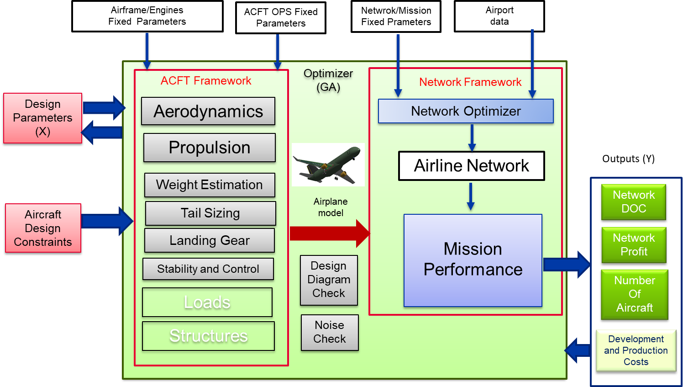
Methodology – Proposed Framework
High fidelity Aircraft Design disciplines
Design Consistency Checks (Noise and Design Diagram);
Airline Network optimization algorithm based on gravitational passenger demand model;
Genetic Algorithm used as Optimizer.

Slide 33
Methodology – Design Variables for airplanes
Airplanes are described by the following design variables in the optimization process:
# | Parameter | Symbol | Range | Baseline ACFT value
1 | Wing Reference Area (m²) | Sw | 72 to 130 | 76.0
2 | Wing Aspect Ratio | ARw | 7.5 to 10 | 8.6
3 | Wing Taper Ratio | Tr | 0.25 to 0.50 | 0.34
4 | Wing quarter-chord sweepback angle (deg) | Sweep | 15 to 35 | 23.5
5 | Incidence of the break station (deg) | Ikink | 0 to 1 | 0.0
6 | Wing Twist Angle (deg) | Twist | -5 to -2 | -3
7 | Location of break station | Break | 0.32to 0.40 | 0.38
8 | Engine by-pass ratio | BPR | 4.5 to 6.5 | 5.0
9 | Engine Overall Pressure Ratio | OPR | 25 to 30 | 28.5
10 | Engine Turbine Inlet Temperature (K) | TIT | 1350 to1500 | 1405
11 (*) | Engine Fan Presure Ratio | FPR | 1.4 to 2.5 | 1.9
12 (*) | Engine Design Point Mach Number | eM | 0.74 to 0.82 | 0.78
13 (*) | Engine Design Point Pressure Altitude (ft) | eHp | 33000 to 43000 | 41000
14 | Number of Passengers (single class, pitch 32”) | nPAX | 70 to130 | 78
15 | Number of Seat Abreast | Seats | 4 to5 | 4
16 | Fuselage Height-to-width ratio | Fush2w | 1.0 to1.15 | 1.15
17 | Hstab aspect ratio | ARh | 4 to 5 | 4.35
18 | Vstab aspect ratio | Arv | 0.8 to 1.2 | 0.89
19 (*) | Hstab tapper ratio | Trh | 0.3 to 0.5 | 0.4
20 (*) | Vstab tapper ratio | Trv | 0.2 to 0.5 | 0.3
21 (*) | Design Range | RANGE | 1000-2500 | 1600
22 (*) | Tail Configuration | TailConfig | 0= T , 1 =l conv | 1
23 (*) | Engine Configuration | EngConfig | 0= tail, 1=tail | 1
24 (*) | Winglet Presence | Winglet | 0= none, 1= with | 1
25 (*) | Slat Presence | Slat | 0=none, 1=with | 1
(*) Added in the last versions of the optimization framework

Slide 34
Methodology – Fixed Parameters
Airframe/Engines
# | Parameter | Symbol | Value
1 | Number of galleys and toillets |  | 1-2
2 | Number of aisles | Naisles | 1
3 | Aisle width (m) | AisleW | 0.50
4 | Seat width (m) | SeatW | 0.46
5 | Maximum cabin height (m) | PCABH | 2.0
6 | Incidence @ wing root (deg) | IR | 2
7 | Wing Dihedral (deg) | WD | 3
8 | Miscelaneous Drag fator (%) | Dmisc | 3.5
9 | Dinamic Pressure efficiency on HT (%) | qHeff | 90.0
10 | Engine minimum clearance to ground (m) | eCLR | 0.40
Aircraft Operational/Certification
# | Parameter | Symbol | Value
1 | Temperature Deviation from ISA (oC) | DISA | 10
2 | Residual Rate of Climb (ft/min) | RROC | 300
3 | Buffet Margin (g) | BuffMGN | 1.3
4 | Speed Limit Below 10000ft (KCAS) | SPDLIM | 250
5 | Required Range with Maximum Payload (nm) | RANGE | 1600
6 | Required Field Length for Take Off (m) | TAKEOFL | 2000
7 | Required Filed Length for Landing (m) | LANDFL | 1500
8 | Maximum Certified Altitude (ft) | Maxalt | 41000
9 | Maximum Cruise Speed (Mach/KCAS) | MMO/VMO | 0.82/340
10 | Maximum Fuel Capacity (kg) | MAXFUEL | 9400
11 | Static Margin (%) | Smargin | 15.0

Slide 35
Methodology – Fixed Parameters
Network and Mission
# | Parameter | Symbol | Value
1 | Aircraft Average Daily Utilization (hours) | DU | 12
2 | Average Turn Around Time (min) | TAT | 45
3 | Takeoff and ClimbOut Fuel allowance (kg) | TOFA | 200
4 | Takeoff and ClimbOut Time allowance (min) | TOTA | 3
5 | Approach and Landing Fue allowance (kg) | AFA | 100
6 | Approach and LandingTime allowance (min) | ATA | 2
7 | Go Around Fuel Allowance (kg) | GAFA | 200
8 | Go Around Time Allowance (min) | GATA | 3
9 | Holding Time (min) | HOLDT | 30
10 | Minimum Cruise Time (min) | MINCRZTIME | 3
11 | Average Taxi Out Time (min) | TOT | 10
12 | Average Taxi in Time (min) | TIT | 5
13 | Maximum Alternate Airport Distance (nm) | ADIST | 200
14 | Total Passenger Weight with luggage (kg) | PAXWT | 110
15 | Averge Ticket Price (US$) | ATP | 110.00
16 | Average Inflight Delay Cost (US$/min) | IDC | 20.00
17 | Fuel cost (US$/kg) | Cf | 1.00
18 | Ratio Total Operational cost/ Direct Operational Cost | K1 | 1.3
19 | Rati Total Revenue/Ticket Revenue | K2 | 1.1
20 | Average Captain Annual Sallary (US$) | CaptSAL | 100.000,00
21 | Average First Officer Annual Sallary (US$) | FOSal | 85.000,00
22 | Average Flight Attendant Annual sallary (US$) | FASal | 65.000,00
23 | Time Between Overhaul (h) | TBO | 2500

Slide 36
Methodology - Airport and City Econometric Data
A database with all relevant data is crated with all airports from the network, used in the Network Optimization and Mission analysis Modules.
The following data are loaded in each record:
# | Parameter | Symbol
1 | Designator (ICAO) | ID
2 | City Name | City
3 | Airport Reference Point Latitude (deg) | LAT
4 | Airport Reference Point Longitude (deg) | LON
5 | Airport Reference Point elevation (ft) | ELEV
6 | Airport Reference Temperature | Tref
7 | Airport Magnetic Declination (deg E/W) | DMG
8 | Most Used Takeoff Runway | TORWY
9 | Most Used Landing Runway Takeoff Distance Available (m) | TORWY_TODA
10 | Most Used Landing Runway | LARWY
11 | Most Used Landing Runway Distance Avaliable (m) | LARWY_LDA
12 | Average Takeoff Delay (min) | ATD
13 | Average Landing Delay (min) | ALD
14 | City Population | POP
15 | City Catchment area (km) | CA
16 | City Buying Power Index | BPI
17 | Gross Domestic Product | GDP

Slide 37
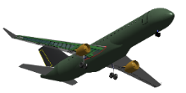
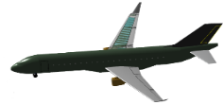
Methodology – Reference Airplane
The reference aircraft is a 4-abreast twinjet, fitted with a pair of 5.0 by-pass turbofan engines, low wings and capable to accommodate 78 passengers in a single class with 32" pitch between seats. It was designed by a optimization framework that utilizes a base of airfoils for wing definition
Pax (32’’ pitch) | Seating abreast | Wing area [m²] | Wing Aspect ratio | Wing sweepback angle | Fly-over noise [EPNdB] | Range (74 pax, MTOW, typical reserves, FL 410) | HT area
74 | 4 | 76 | 8.6 | 23.5 | 82.7 | 1,600 nm | 21 m²
Engine Bypass ratio | Engine overall pressure ratio | Turbine inlet temperature [K] | Maximum thrust @ takeoff (Single engine) [lbf] | MTOW [kg] | OEW [kg] | Fuselage width [m] | Fuselage height [m]
5 | 28.5 | 1405 | 14,400 | 33,188 | 19,106 | 2.91 | 3.18
E175E1 presentes greater range therefore higher MTOW

Slide 38
Methodology – Objective Functions
Maximize Network Profit per unit of transport momentum (NP):
Minimize Network Direct Operational Cost (NDOC) :
Where:
a = number of aircraft types ( = 3)
ATP = Avergae Ticket Price [$]
DISTi,j,k = Distance on sector ij flown by aircraft k
NPAXk = Passenger capacity of aircraft k
DOCij = Direct Operational Cost on sectot ij for aircraft type k
FREQij = Frequency on sector ij for aircraft type k
Lfij = Loadfactor on sector ij
ID = Inflight delay cost ($20/min)
DDi = Depature delay (air traffic)
Adj = Arrival delay (air traffic)
K1 = Revenue to ticket price ratio (assumed 1.1) , K2 = Total COST to DOC ratio ( assumed 1.3) ;

Slide 39
Methodology
Airplane Model Constraints
ICAO noise certification levels at the three certification points
Fuel storage - all mission fuel must be accommodated in the wing fuel tanks.
Performance and certification requirements: rate of climb at initial cruise altitude, available thrust to power the airplane at desired service ceiling, climb rate in 2nd segment, missed approach, takeoff balanced field length and landing field length, minimal cruise altitude taking off with MTOW.
Airplane stall must begin in the inner wing.
Longitudinal flight quality level 3.
Divergence Mach number.
Static margin (iterative process for tail sizing and wing positioning).
Critical angles and clearance boundaries for landing gear design.

Slide 40
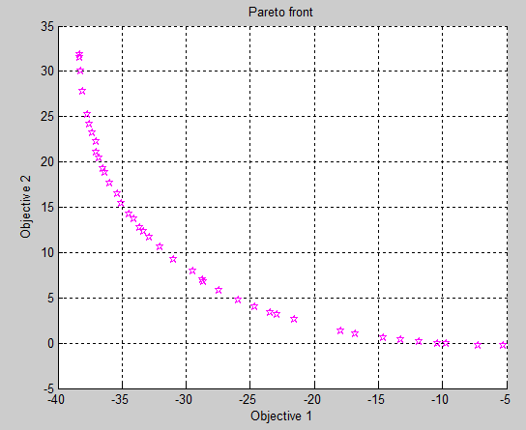
Methodology - Genetic Algorithms
GA differs substantially from more traditional search and optimization methods. Main differences are:
Search a population of points in parallel, not a single point.
Does not require derivative information or other auxiliary knowledge. Only the objective function and corresponding fitness levels influence the directions of search.
Uses probabilistic transition rules, not deterministic ones.
Works on an encoding of the parameter set rather than the parameter set itself.
It is important to note that the:
GA provides a number of potential solutions to a given problem and the choice of final solution is left to the user;
In cases where a particular problem does not have one individual solution, for example a family of Pareto-optimal solutions, (as is the case in multiobjective optimization) then the GA is potentially useful for identifying these alternative solutions simultaneously.

Slide 41
Methodology - Optimizer
A Non-dominated Sorting Genetic Algorithm (NSGA-II) was initially chosen as optimization method due to its robustness and capacity in dealing with global minima or maxima in poor-known search spaces;
Main features:
Modified elitism rule for multi-objective search;
favors individuals that can help to increase the diversity of the population even if they have a lower fitness value – faster convergence to the Pareto Front;
A fast non-dominated sorting routine;
Allows continuous and binary-coded (discrete) variables;
Constraint handling does not make use of penalty parameters;
Concurrent evaluation of n independent individuals (n = number of generations);

Slide 42
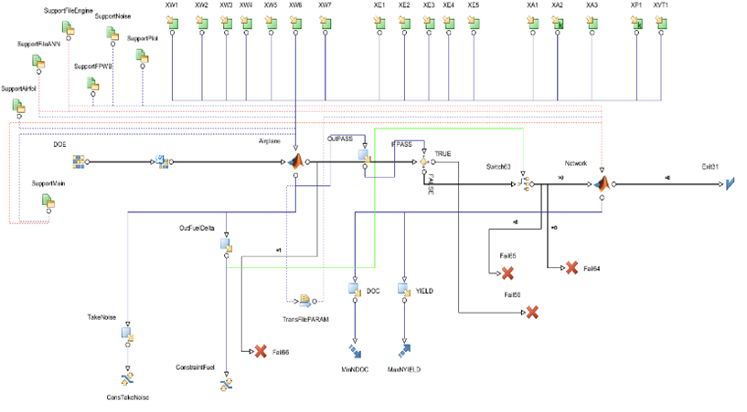
Methodology – MDO Framework
The MDO Framework was elaborated by using the modeFrontier® integration platform. Basically, there are two MATLAB® nodes where the airplane and network characteristics are calculated.

Slide 43
AIRCRAFT FRAMEWORK
DISCIPLINES

Slide 44
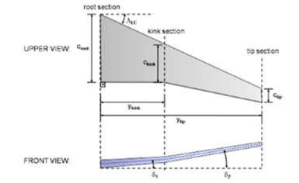
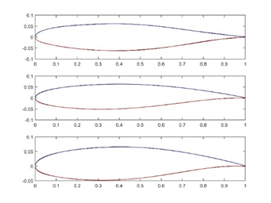
Methodology - Disciplines
Aerodynamics
Lift Distibution and Wing Drag determined using Class-III methodology:
Artificial Neural Network (ANN).
Ref:erence: “Ney R. Secco and Bento S. Mattos. "Artificial Neural Networks Applied to Airplane Design", 53rd AIAA Aerospace Sciences Meeting, AIAA SciTech Forum, (AIAA 2015-1013)”
Multi Layer Neuron Network: 3 layers (50-50-1) , feed forward;
Hyperbolic transfer function;
ANN training:
100,000 configurations database;
Back propagation algorithm;
Full potential code used on aerodynamic evaluations (BLWF2.8).
Airfoil geomectric parameters for tip,root and kink.
Sobieczky Polynomial parametrization.
Parameters: r0, t/cmax, phi,X_tcmax, theta, epsilon, Ycmax, Yctcmax, X_Ycmax.

Slide 45
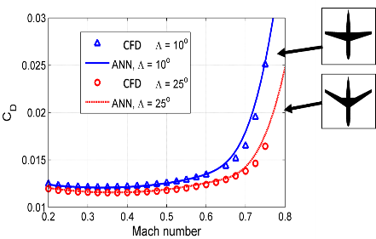
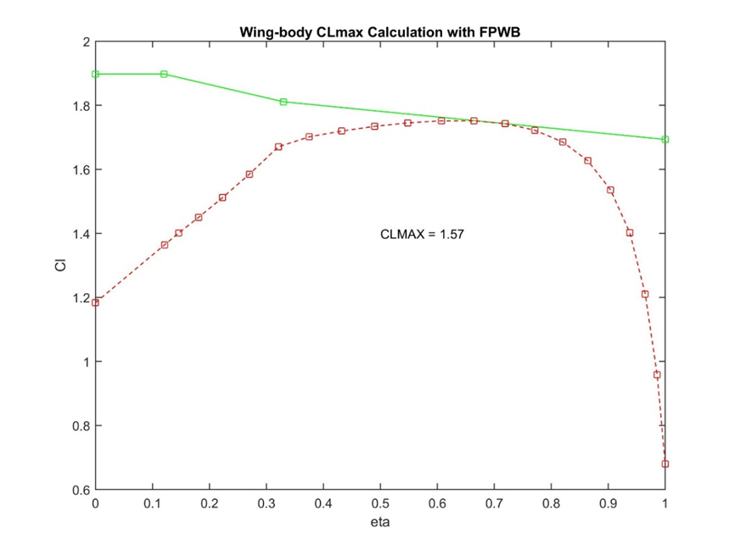
Methodology - Disciplines
Aerodynamics
To verification of the accuracy of the ANN prediction, some analyses of drag divergence was performed using two airplane configurations, which were not used in the training phase.
The Critical Section Method was adopted for the estimation of clean wing maximum lift coefﬁcient. For this, a full potential works in conjunction with the XFOIL panel code.

Slide 46
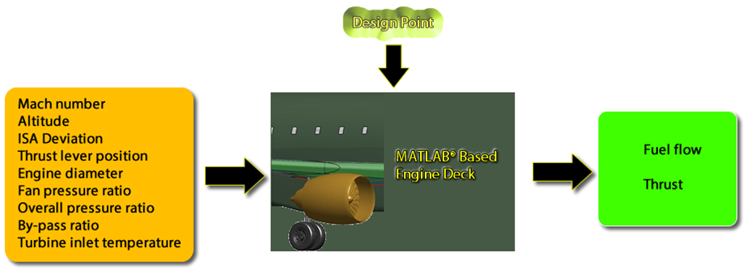
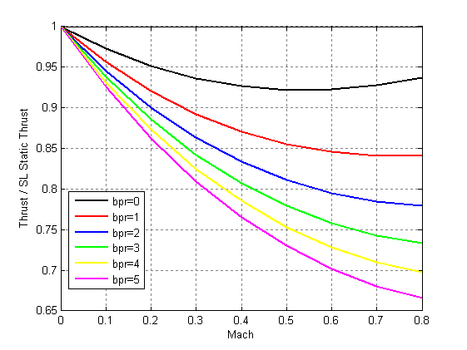
Methodology - Disciplines
Propulsion
T. Benson, "An interactive educational tool for turbojet engines," in 31st AIAA Joint Propulsion Conference and Exhibit, San Diego, 1995.
Based on the thermodynamic model proposed by Benson (1995), developed for turbojet and turbofan engines. It is adapted from open source code developed by NASA Glenn Research Center;
Two steps are built in constructed in the module: the design step is where all engine characteristics are raised at a given design point (a cruise condition with 98% throttle setting) and an analysis module, where it is possible to calculate the engine thrust and fuel flow rate from the geometric characteristics obtained in the design step.
An updated version containing compressor efficiency obtained from a compressor map modeled with radial basis function from MATLAB® was implemented in the airplane calculator but was not employed in the present design simulations;
Calculated engine parameters are used in the Noise Check Module.

Slide 47
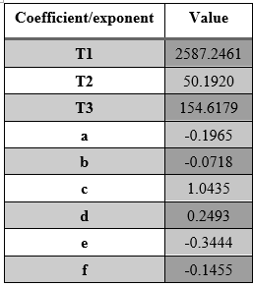
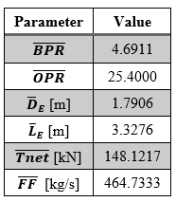
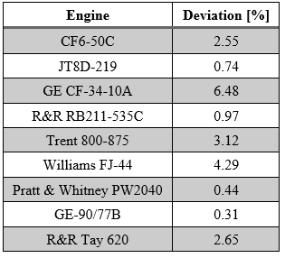
Methodology - Disciplines
Propulsion - Engine Weight Estimation
Most of the engine weight estimation methods used in academy are derived from Reymer’s empirical formulae [52] , based on data from first and second-generation jet engines.
Thus, a new method for turbofan engines weight estimation (applicable the aircraft loaded in the databases) is proposed for this study, according to:
The coefficients and exponents of such equation are obtained by an optimization using a genetic algorithm The objective is the minimization of the square mean error of known engine weights, elaborated from a database comprised of over 20 engines, which embraced a large variety of turbofan engines

Slide 48
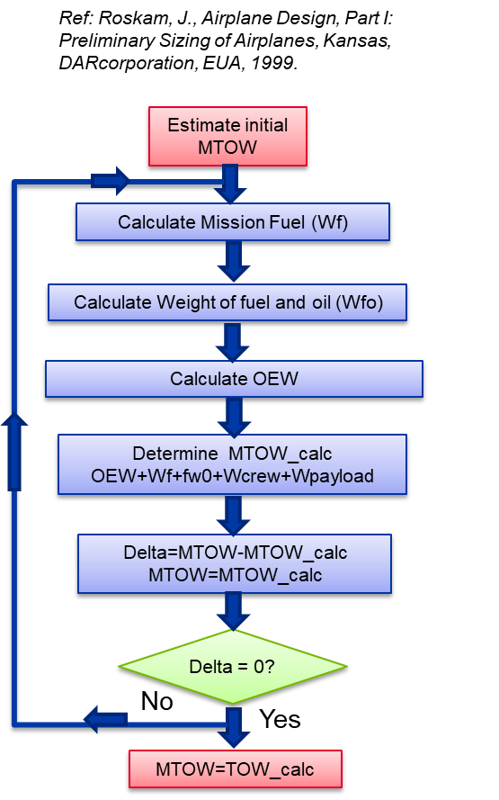
Methodology -Disciplines
Weight Estimation (OEW and MTOW)
Weight of pylons, fuselage, empennage, systems, landing gear and engines are calculated separately using Class II methodology;
Wing weight is calculated by sizing the wingbox to withstand loads calculated with a full potential code in some few maneuvers in the flight envelope; the secondary structure being estimated by empirical method.
MTOW determined interactively using Mission Analysis module considering a selected operational profile:
ISA conditions, no Wind.
Takeoff and Landing from Sea Level.
Payoad: NPAX*PAXWT;
Design Range;
Alternate distance (200nm)
Climb, Cruise and Descent speeds:
250/280KIAS/Mach 0.78 (clb and des), Max ML/D(crz).
Optimum Cruise Alt (best specific range, 1.3g buffet margin).

Slide 49
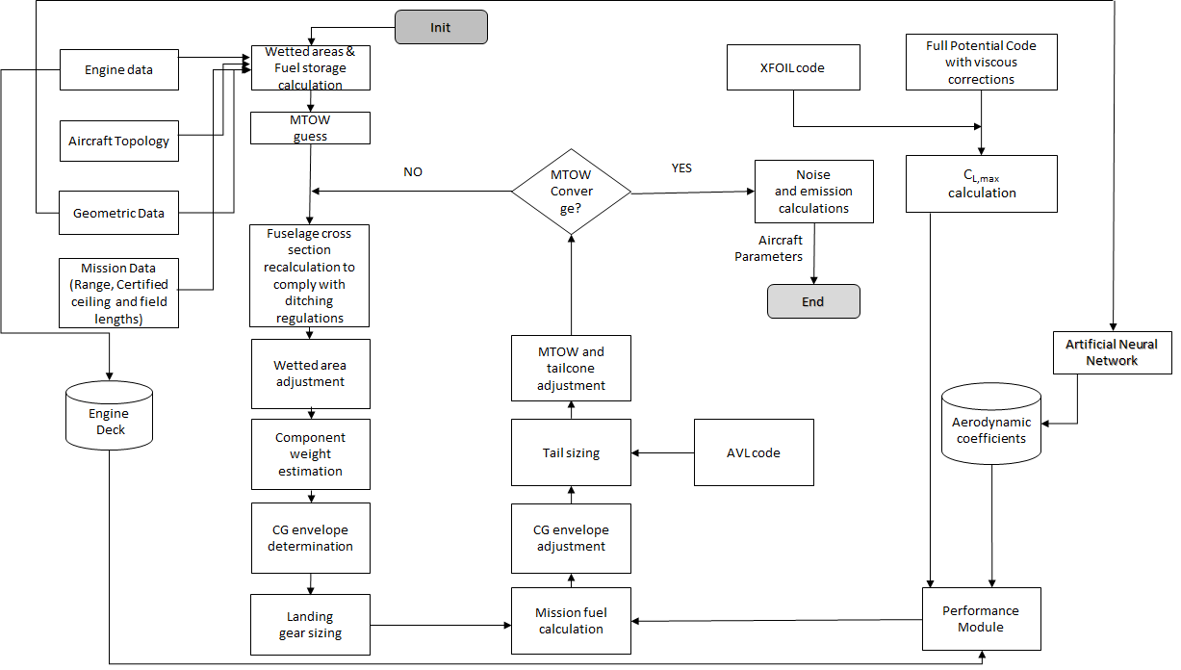
Methodology -Disciplines
Weight Estimation (OEW and MTOW)

Slide 50
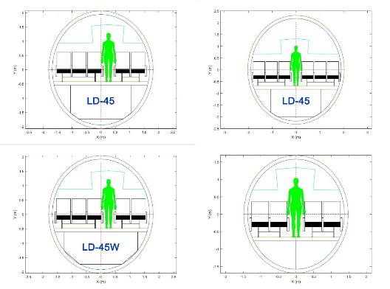
Methodology -Disciplines
Weight Estimation – Fuselage Sizing
A MATLAB® code was developed to design the cross section of the passenger cabin.
A considerable sort of cargo containers can be incorporated into the configuration. The code has input such as seat width, aisle width, cabin height and other considered important to the fuselage sizing.

Slide 51
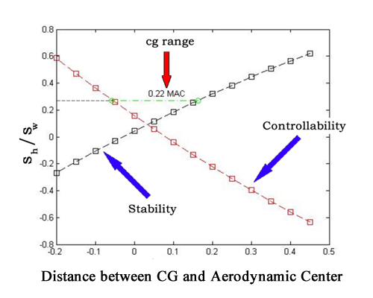
Methodology -Disciplines
Weight Estimation – Tail Sizing
A methodology based on static stability and controllability criteria was then elaborated and integrated into a MATLAB® application conceived for airplane design;
The VT area is obtained by taking the larger area from that calculated employing both criteria, while the HT area is obtained with integration of the two criteria. The permissible areas of emphasis are located between the straight lines from the controllability and the stability requirement minus the degree of stability;
Engine failure at takeoff considered on VT design (FAR 25.149);
Stability derivatives that are needed for the calculation of HT and VT areas were obtained with the AVL code from MIT.

Slide 52
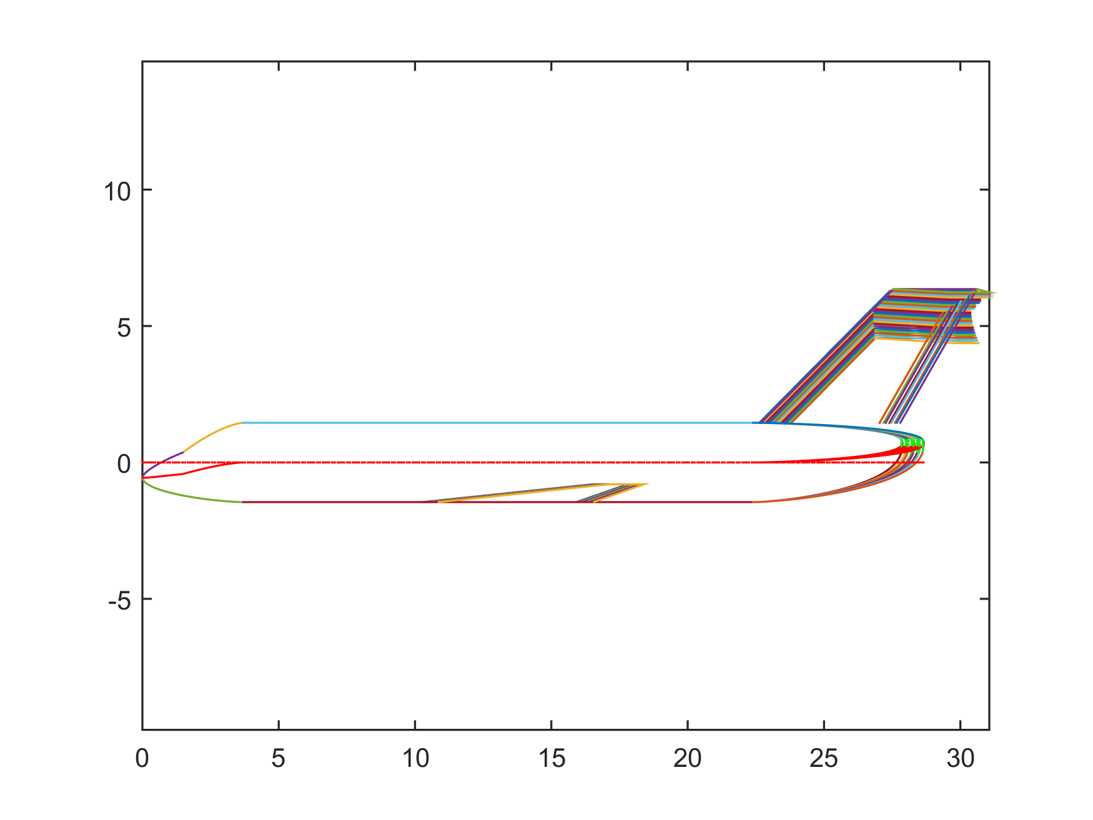
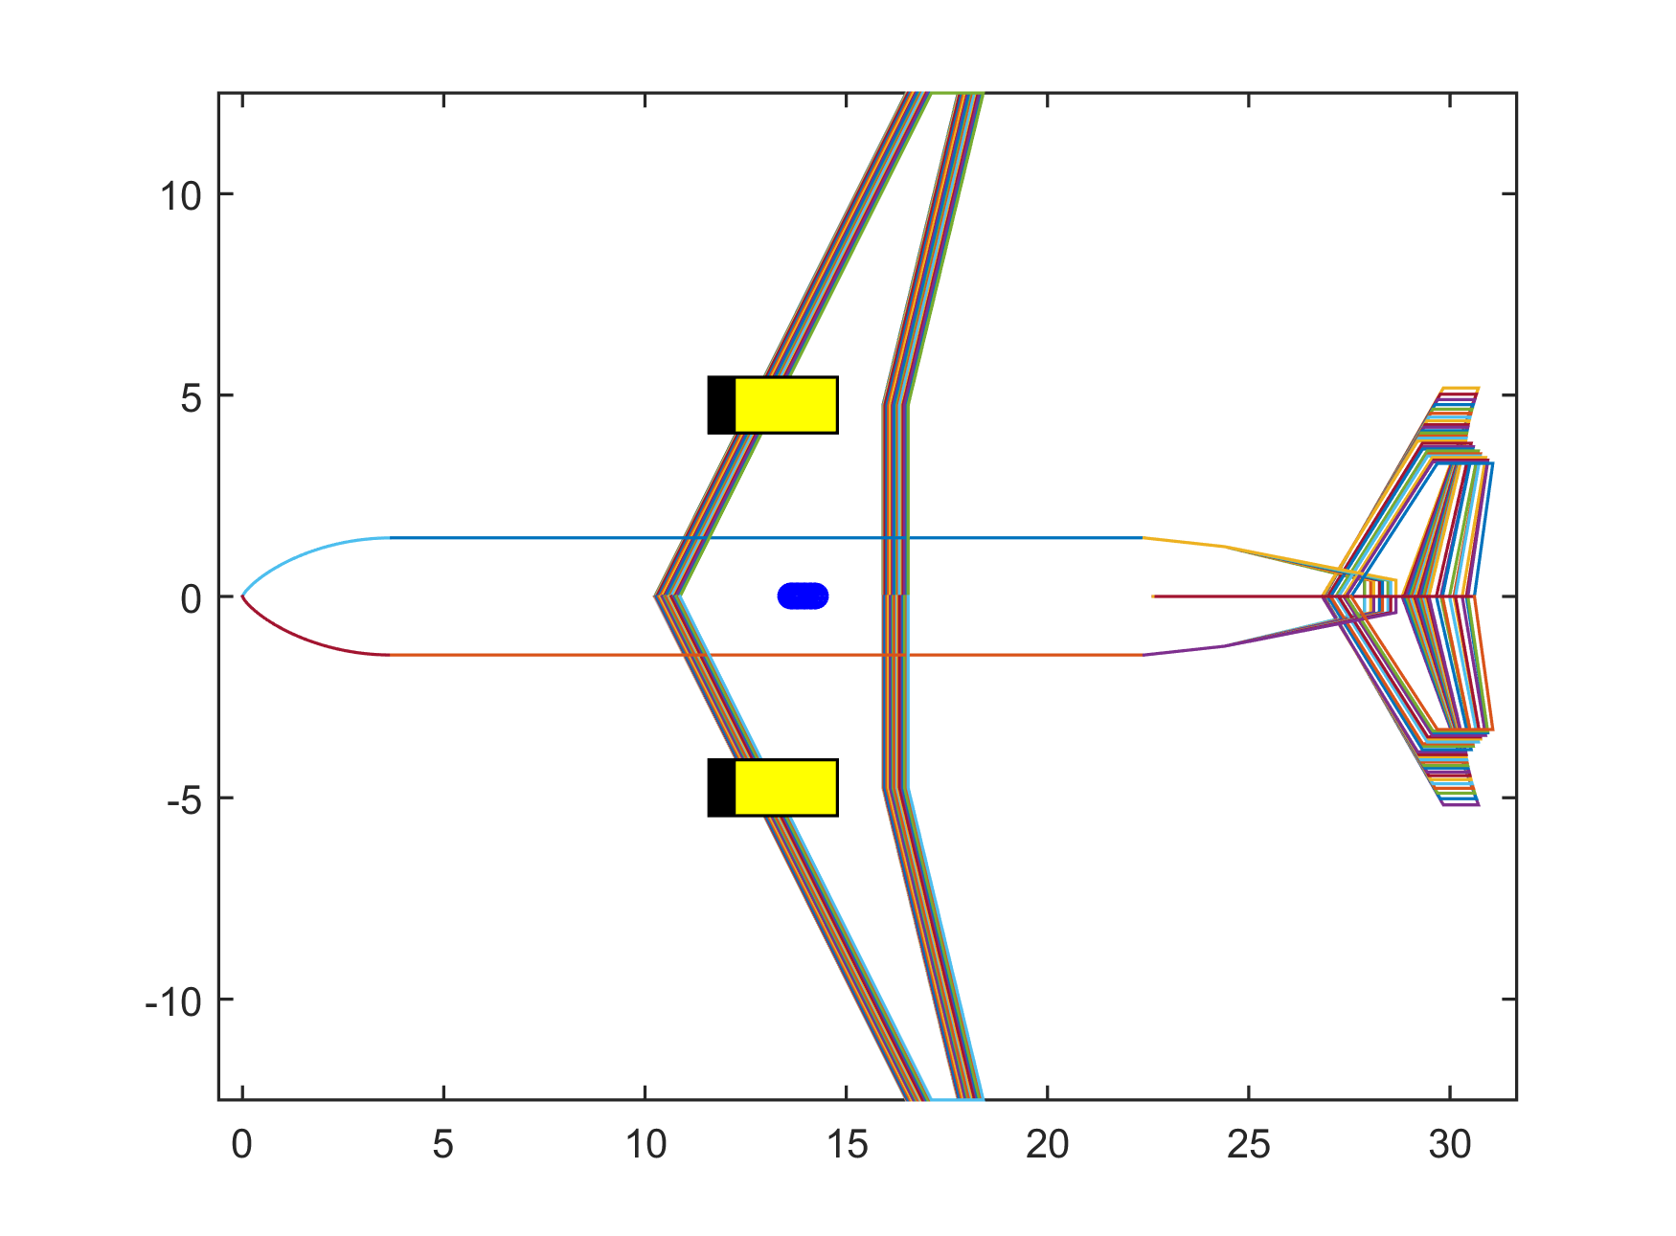
Methodology -Disciplines
Weight Estimation – CG location
Incorporation of a more sophisticated methodology for the tailplane sizing poses a more complex task in the interactive process for MTOW calculation;
The determination of the cg location is needed not only for the tailplane area calculation, but for the positioning of the wing, and the main and nose landing gears, which are also dependent on the overall cg location;
CG location will guide the wing placement in the configuration.

Slide 53

Methodology -Disciplines
Landing Gear Design
Designed to withstand static and dynamic loads
Engine clearance to ground is a constraint
Wheels of MLG must be accommodated inside the wing-fuselage fairing
Wake from the MLG wheels must avoid hitting the inner flaps
MLG wheels chosen by minimum weight criterium
NLG wheels chosen by lower radius criterium

Slide 54
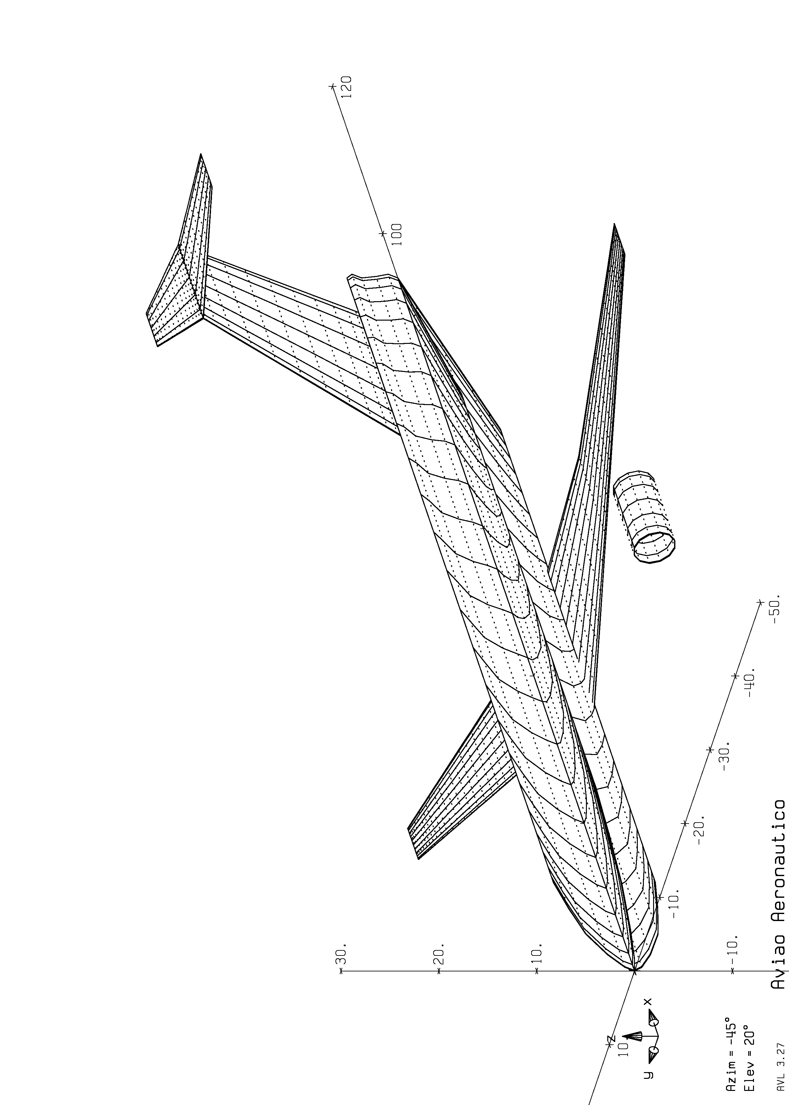
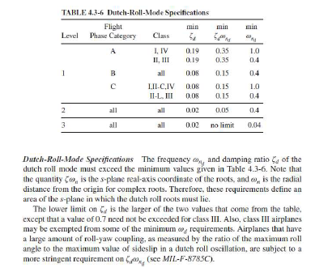
Methodology -Disciplines
Stability and Control
Stability derivatives obtained via AVL code (Full potential - MIT)
Inertia properties estimated via Class I method (Roskan);
Longitudinal and Lateral dynamic modes determined and checked against MIL-STD-1797B requirements (minimum Level 2 required);

Slide 55
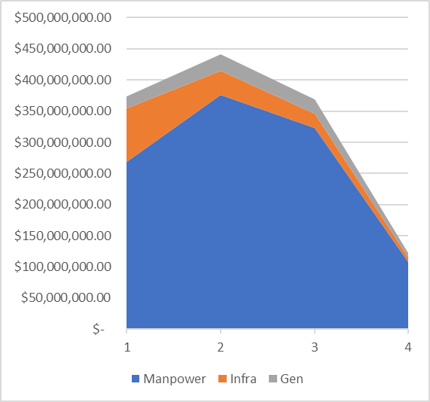
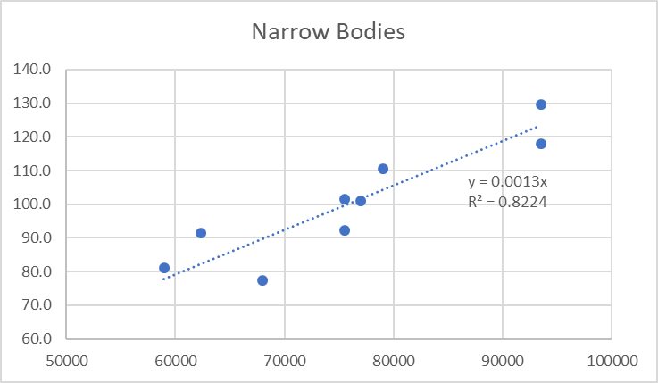
Methodology – Cashflow Net Present Value (NPV)
Mattos, B. S., J. A. T. G. Fregnani, and P. E. C. S. Magalhães. "Conceptual Design of Green Transport Airplane." (2018). Chapter 5. Bentham Books. Sharjah, UAE.
Aircraft’s Development and Production costs calculated based on Mattos et. Al (2018) methodology:
ERJ145’s Program costs as baseline;
Adjustments considering aircraft’s MTOW, Passenger´s capacity, Maximum Certified Takeoff thrust and Wing Area (wS);
15 years lifecycle: 4 years development + 11 years operations.
Development (non-recurring) Costs: Manpower, Infrastructure and administrative.
Production (recurring) Costs: Material, Manpower, Processing, Sales and General.
Deliveries based on major manufacturers’ (Boeing, Airbus and Embraer) World Market Forecast for regional aircraft. Assumes the manufacturer has 60% of Market Share.
Aicraft price:
Based on Airbus price list (23/12/2018);
Linear price model with MTOW;
0.5% of price discount for each 1% of Marker Share.

Slide 56
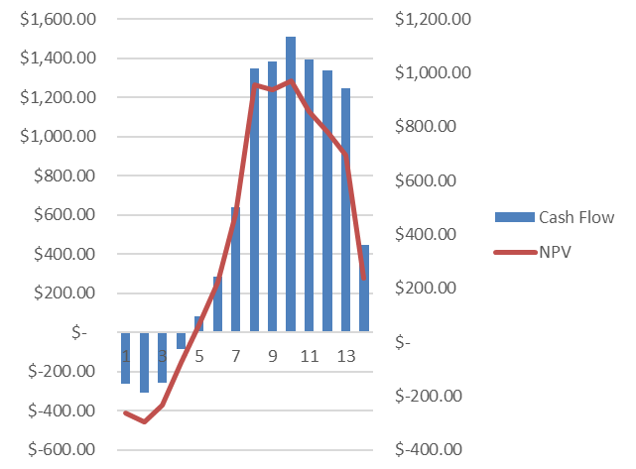
Methodology – Cashflow Net Present Value (NPV)
Mattos, B. S., J. A. T. G. Fregnani, and P. E. C. S. Magalhães. "Conceptual Design of Green Transport Airplane." (2018). Chapter 5. Bentham Books. Sharjah, UAE.
Cashflow’s Net Present Value (NPV) considers 5% annual inflation;
Aicraft Program is considered viable if the Internal Interest Rate (IRR) is higher than 30% in the whole lifecycle (included as constraint in the optimization flow).

Slide 57
AIRCRAFT CERTIFICATION
CONSISTENCY CHECKS

Slide 58
Methodology – Consistency Checks
Design Diagram
The selected aircraft design must be checked against FAR25/operational performance requirements before running the mission/network calculations.
Class-I methodology is applied (closed formulas);
Claculation based on airframe/engine geometric parameters.
CD0 and Wet Area estimation.
Drag estimation for landing gear/flaps.
Required Thrust-to-weight ratio (T/W) is determined in the following design conditions as function of calculated wing loading:
Takeoff at sea level (MTOW, Selected TOFL)
OEI 2nd Segment Climb – FAR 25.111 (2.4% clb grad for 2 eng);
Missed Approach (approach and landing climb) – FAR 25.121 & 25.119;
Cruise (MMO) ;
Residual Rate of climb at Max Certified Ceiling (300 fpm);
Loftin Jr, L. K. (1980). Subsonic Aircraft: Evolution and the Matching of size to Performance.
Ref: Roskam, J., Airplane Design, Part I: Preliminary Sizing of Airplanes, Kansas, DARcorporation, EUA, 1999.

Slide 59
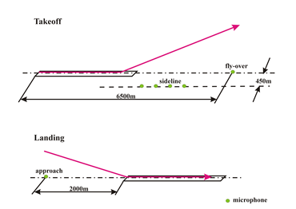
Methodology – Consistency Checks
Noise Certification
Bento Mattos and Paulo Magalhaes. "Conceptual Optimal Design of Airliners with Noise Constraints", 50th AIAA Aerospace Sciences Meeting including the New Horizons Forum and Aerospace Exposition, Aerospace Sciences Meetings
Based on the model proposed by Mattos and Magalhães (2012);
Calculation the noise signature in the three ICAO reference points: fly-over, sideline, and approach.

Slide 60
NETWORK FRAMEWORK
DISCIPLINES

Slide 61
Methodology - Network Disciplines
Mission Performance
This module was implemented in MATLAB® language embedding the aircraft performance calculations necessary to determine trip fuel (W_{f}) and time (T) for each given range (DIST) and Takeoff Weight (TOW), afterwards used to compute the Direct Operational Cost (DOC) related to the sector.
Inputs from the aerodynamics module (C_{D}, C_{L}) and propulsion (net thrust and fuel flow) modules are necessary for the application of mass point equations to determine delta fuel ant time at integration steps, at a given performance state (weight and environmental conditions at altitude) and operational flight profile.
Environmental conditions (pressure, density and temperature) at each integration point, as function of pressure altitude, are calculated as per the International Standard Atmosphere isentropic model.
Along the vertical flight path the equations of motion are numerically integrated considering steady states segments in climb, cruise and descent according to :

Slide 62
Methodology – Network Disciplines
Mission Performance
In steady state and small flight path angles γ (absolute value < 5o, typical for commercial airplanes) we have:

Slide 63

Methodology – Network Disciplines
Mission Performance – Operational Flight Profile (OFP)
Considers a realistic transport airliner operational profile as below:

Slide 64

Methodology – Network Disciplines
Mission Performance – Operational Flight Profile (OFP)
Segment A( Climb to 10,000 ft)
From pressure altitude of 1,500 ft above the elevation of the most used runway for takeoff the aircraft climbs maintaining maximum climb thrust and constant calibrated airspeed of 250 knots (respecting Air Traffic Control speed restriction requirements) until a pressure altitude of 10000 ft. Fuel and time quantity allowances are added to computations representing the aircraft maneuvering necessary for takeoff run, lift off and gear/flap configuration changes.

Slide 65
Methodology – Network Disciplines
Mission Performance – Operational Flight Profile (OFP)
Segment B (Climb with Constant CAS)
At 10,000 ft pressure altitude the aircraft then accelerates in a levelled segment to a calibrated airspeed of 280 knots and then climbs at maximum thrust maintaining this speed until the Mach-Crossover Altitude or Cruise Altitude, whichever is lower. The Mach-Crossover Altitude is the pressure altitude where the number of Mach reaches the prescribed cruise Mach number.

Slide 66
Methodology – Network Disciplines
Mission Performance – Operational Flight Profile (OFP)
Segment C (Climb with Constant Mach)
From the Mach-Crossover Altitude the aircraft climbs at maximum thrust with constant number of Mach (calculated cruise Mach number) to the selected cruise altitude.

Slide 67
Methodology – Network Disciplines
Mission Performance – Operational Flight Profile (OFP)
Segment D (Cruise at Optimum Altitude and Mach Number)
The cruise segment is performed at constant number of Mach that is derived from the maximum M L⁄D condition.
The cruise altitude corresponds to the optimum cruise altitude adjusted to the suitable flight level as per the Reduced Vertical Separation Minima (RVSM) air traffic rules.

Slide 68
Methodology – Network Disciplines
Mission Performance – Operational Flight Profile (OFP)
Segment D (Cruise at Optimum Altitude and Mach Number)
The optimum cruise altitude is calculated as the minimum of:
Maximum certified ceiling (fixed as 41,000 ft in this study).
Maximum specific range altitude (considering the selected cruise speed and takeoff weight).
Maximum altitude where the residual rate of climb is 300 ft/min
Maximum altitude where 1.3g buffet (stall) margin is achieved. The latest considers stall at 40° bank angle in clean configuration and is calculated according to:

Slide 69
Methodology – Network Disciplines
Mission Performance
Segment E (Descent with Constant Mach to Mach-Crossover Altitude)
from top of descent the aircraft descents at idle thrust with cruise Mach number to the Mach-Crossover Altitude, where a calibrated airspeed of 310 kt is reached.

Slide 70

Methodology – Network Disciplines
Mission Performance
Segment F (Descent with Constant CAS to 10,000 ft)
From the Mach-Crossover Altitude, a constant calibrated airspeed of 310 kt is maintained in the descent flight at idle thrust to 10,000 ft pressure altitude where the airplane is decelerated in leveled flight to a calibrated airspeed of 250 kt.

Slide 71
Methodology – Network Disciplines
Mission Performance
Segment G (Descent to 1500 ft)
From 10,000 ft pressure altitude, constant calibrated airspeed of 250 kt is maintained in the descent flight at idle thrust to 1500 ft pressure altitude above the landing runway elevation where the airplane initiates the approach and landing phase. Fuel and time quantity allowances are added to computations representing the aircraft maneuvering necessary for approach, gear/flap configuration changes and landing.

Slide 72

Methodology – Network Disciplines
Mission Performance
The total fuel loaded on board (FOB) is determined considering the minimum fuel required as per the Brazilian regulations for transport aircraft (RBAC 121.645), considering the flight profile in analysis with the alternate flight profile.

Slide 73

Methodology – Network Disciplines
OFP Calculation Routine
The OFP Calculation Routine is designed to calculate total fuel (Wf) and Time (T) in the integrated flight segments (climb, cruise and descent) sequence;
It is constructed considering a forward sequence computation, starting at the origin airport;
For that it is necessary and interactive algorithm in order to determine the top of descent point (ToD);
0.05nm is used as tolerance for convergence of the ToD point.

Slide 74

Methodology – Network Disciplines
Mission Performance - Algorithm
The Mission Performance Calculation Algorithm is designed to interactively determine the TOW based on regular fuel reserves computation and given ZFW;
It each interaction it calls the OFP Calculation Routine to compute Wf.
Payload-Range envelope limits (MZFW,MLW,MTOS and MAXFUEL) are checked in this process.

Slide 75

Methodology – Network Disciplines
Mission Performance – DOC Calculation
ROSKAM, J. Airplane Design, Part VIII - Airplane Cost Estimation: Design, Development, Manufacturing and Operating. Ottawa: DARcorporation, 1999.
DOC Calculation uses Roskam’s methodology [41]:
Function of MTOW, Block time (T+TAT) and Block Fuel (Wf+Taxifuel);
Closed formulas for cost componentes;
No Cost Index direct dependency (may be derived bakwards from formulas).
Five cost components considered:
Flight Cost (Cflt) :crew, oil, fuel and ensurance;
Maintenace Cost (Cmnt): airframe labor, engine labor and airframe/engines material;
Depreciation Cost (Cdepr): airframe, engines, avionics, airframe/engine parts and others;
Fees Cost (Cfee): Navigation, Airport and Register;
Financial costs (Cfin): leasing and acquisition.
$$\begin{matrix}DOC={DOC}_{flt}+{DOC}_{maint}+{DOC}_{depr}+{DOC}_{fee}+{DOC}_{fin} & (\$/nm)\end{matrix}$$

Slide 76

Methodology – Network Disciplines
Mission Performance – DOC Calculation / Crew Salary
ROSKAM, J. Airplane Design, Part VIII - Airplane Cost Estimation: Design, Development, Manufacturing and Operating. Ottawa: DARcorporation, 1999.
Yearly crew salaries determined as a linear function of MTOW.
Based on US Pilot´s association (www.airlinescentral.com data filtered by:
9 types Narrow body aircraft;
10 major domestic Airlines;
12 years of seniority.

Slide 77


Methodology – Network Disciplines
Takeoff Performance
Roskam, J. Airplane Design, Part I – Prliminary Sizing of Airplanes. Ottawa: DARcorporation, 1999.
Torenbeek, E. "Synthesis of subsonic airplane design, 1982." Delft: Springer.
Inverse Calculation Method: Weight associated to a given OAT, field elevation, flap setting and runway length (TODA and ASDA);
MTOW (used in Mission Calculation module) is limited to Regulated Takeoff Weight (RTOW) defined as minimum of:
Balanced Field Limit Weight - Torembeek ‘s methdology;
2nd Segment Climb limit (FAR 25.121);
Takeoff Flaps, Gear Up, MaxT/O Thrust, 1 engine out
Maximum Structural Takeoff Weight (MSTOW);

Slide 78


Methodology – Network Disciplines
Landing Performance
Roskam, J. Airplane Design, Part I – Prliminary Sizing of Airplanes. Ottawa: DARcorporation, 1999.
Torenbeek, E. "Synthesis of subsonic airplane design, 1982." Delft: Springer.
Inverse Calculation Method: Weight associated to a given OAT, field elevation, flap setting and runway length (LDA);
MLW (used in Mission Calculation module) is limited to the Regulated Landing Weight (RLW) defined as minimum of:
Landing Field Limit Weight – Torembeek´s methodology.
Approach Climb Limit Weight(FAR 25.121)
Approach Flap 5 deg, Gear Up, G/AThrust, 1 engine out
3. Landing Climb Limit Weight(FAR 25.119)
Landing Flap , Gear Down, G/A Thrust, all engines
4. Maximum Structural Landing Weight (MSLW).

Slide 79

Methodology – Network Disciplines
Network Optimization
Jaillet, Patrick, Gao Song, and Gang Yu. "Airline network design and hub location problems." Location science 4.3 (1996): 195-212.
“Optimization inside optimization”.
Modification of Jaillet’s methodology;
2-stop model and profit maximization (instead of minimizing DOC).
3 aircraft types networks solved simultaneously;
DOCs used in the algorithm considers Wf and T calculated via OFP module with:
Aircraft’s design range and ZFW associated to full passengers capacity;
Sea level airports and ISA conditions.
Mixed Integer Linear Programming Problem (MILP) type:
Matlab solver used (function intlinprog).
Output:
Number of frequencies required per each sector connected, for each aircraft fleet.
Potential Hubs may be identified.

Slide 80

Methodology – Network Disciplines
Network Optimization – MILP Model
Let $X_{iltj}$ be the fraction of the passenger’s demand flow $f_{ij}$from origin i to destination j, served by a two-stop connecting flight through cities l and t, $Y_{ijk}$ the number of aircraft type $k$ used in the route from city i to j, p the average fare per passenger ($),$c_{k}$ the average operational cost ($/nm) at design range , b_{k} the passenger capacity of aircraft k, the reference load factor LF_{ref} and d_{ij} the distance between origin and destination airports. The following mixed integer linear programming model is proposed:
The objective function (1) is set to maximize the network profit, based on the difference between the average revenue and the average cost per unit of transport (passenger.km or passenger. nm) ;
Constraint (2) states that the fractional flow on route ij cannot exceed the total capacity of the aircraft assigned;
Constraint (3) ensures that the passenger flow from a direct flight from i to j is non-negative;

Slide 81




Methodology – Network Disciplines
Network Optimization – 2 stop model
It is assumed that 50% of all passenger demand from i to j (fij) are derived from direct flights $(X_{ij}$), 30% distributed equally among all one-stop flights $(X_{itj})$ and 20% distributed equally among two-stop flights $(X_{iltj})$ .
Intermediate stop
Airport t
$X_{itj}$ (30%)
$X_{ij}$(50%)
$X_{itj}$ (20%)
Origin
Airport i
Destination
Airport j
Intermediate stop
Airport l

Slide 82

Methodology – Network Disciplines
Demand Model
Grosche, Tobias, Franz Rothlauf, and Armin Heinzl. "Gravity models for airline passenger volume estimation." Journal of Air Transport Management 13.4 (2007): 175-183.
Passenger’s demand between pairs based on Gravitational Model as proposed by Grosche et.al (2007) considering:
Population
Catchment area;
Buying Power Index;
Gross Domestic Product;
Geographical Distance;
Average Travel Time;
Demand Model calibrated via Linear Regression on actual data from 2014,2015 and 2016.
Geographical Distances between city pairs based on GCD+3% (hypersine formula based);

Slide 83
Methodology – Network Disciplines
Network Parameters
Number of nodes | N | Total number of airports served
Degree of Nodes | D | The degree of a node in an aviation network refers to the number of airports having direct flights with this airport (node); greater degree of a node means greater importance to some extent.
Average Degree of Nodes | D avg | The average degree of a network refers to the average value of all degrees of nodes in the network
Average Path Lenght | L | Depth of the air transport, which is a property of the transport shortcut in the integral network; the shorter the average path length is, the less transit times are required between any two airports, bringing more convenience for the passengers.
Network Desity | ND | The ratio of actual connection number to the maximum possible connection numbers in the figure. In an aviation network, it describes the ratio of actual number of opened segments to the number of all possible segments.
Clustering | Ci | The ratio of the actual connection number to the maximum possible connection edges between this node and its adjacent nodes. In an aviation network, the clustering coefficient of a node indicates the average cluster degree of the local network comprised of the airport and its adjacent airports
Betweeness | B | Betweenness is generally defined as the capability of a node for controlling the connection of other node pairs, i.e., the effect of a node acting as a bridge between other node pairs
BOEING PROPRIETARY
ECCN:EAR99

Slide 84



Methodology – Network Disciplines
Network Parameters
The most important indicators to characterize the network topologic structure are:
The average path length (L) => air transport depth.
The average clustering coefficient (C) => air transport width.
With a smaller average path length and a bigger clustering coefficient, the higher is the network efficiency.
This means better performance and a stronger fault-tolerant capability.
BOEING PROPRIETARY
ECCN:EAR99

Slide 85

Methodology – Network Disciplines
Mission Analysis
In this module the key results related to all air transport networks and all fleets of airplanes are aggregated;
The computations of total network profit (NP) and total network DOC (NDOC) are done via Eq. 25 and Eq.26 , as function of route frequencies ($Yijk)$, departure and arrival delays (${DD}_{i} and {AD}_{j}$), average delay cost per minute (ID), sector distance (${DIST}_{ijk})$, aircraft passenger capacity ( $b_{k})$ and average ticket price ($p)$ as follows:
In addition, the fleet size required in each aircraft type k may be estimated as function of sector block time (${TB}_{i,j}$) and average daily utilization (DU) according to:

Slide 86
STUDY CASES
Optimum aircraft for a given network
Optimum aircraft on optimum network
Optimum three aircraft fleet on optimum networks

Slide 87

Study Case 1 - Optimum aircraft on a given network
B. S. Mattos, J. A. Fregnani e P. C. Magalhães. ”Chapter 7: An Innovative Approach for Optimal Airplane Design Encompassing an Airline Network. Conceptual Design of Green Transport Airplane”. Book Series: Frontiers in Aerospace Science ed., vol. 3, Bentham Books, 2018.
Objective: to the test the concept of the proposed MDO framework determining the optimal airplane that fits into a given airline network;
Network optimization module switched off;

Slide 88

Study Case 1 - Optimum aircraft on a given network
1 aircraft type (range limited to 1600nm);
Regional Airline connecting 5 main Brazilian airports;
Given 16 routes system between GRU,GIG,POA,BSB and SSA;
Given demand (passengers transport only);
Main hub at GRU (são Paulo);
10% Market share;

Slide 89

Study Case 1 - Optimum aircraft on a given network
Airport information extracted from the Brazilian AIP

Slide 90
Study Case 1 - Optimum aircraft on a given network
Distances dij (used in the network optimization module) and true headings Θij (used in the mission analysis module) between city pairs are determined via haversine formula for loxodromic routes [60], according to:
Magnetic Courses (True heading + Magnetic declination)
 | SBGR | SBGL | SBBR | SBPA | SBSV
SBGR | 0 | 099 | 009 | 229 | 059
SBGL | 278 | 0 | 347 | 240 | 048
SBBR | 189 | 168 | 0 | - | 095
SBPA | 051 | 064 | - | 0 | -
SBSV | 236 | 226 | 272 | - | 0
Route Distances (nm)
 | SBGR | SBGL | SBBR | SBPA | SBSV
SBGR | 0 | 188 | 475 | 481 | 807
SBGL | 188 | 0 | 509 | 624 | 676
SBBR | 475 | 509 | 0 | - | 603
SBPA | 482 | 624 | - | 0 | -
SBSV | 807 | 676 | 603 | - | 0

Slide 91

Study Case 1 - Optimum aircraft on a given network
Given demand (dummy values);
Load factors selected randomly between 70% and 90%.
Potential Demand (PAX Per day)
 | SBGR | SBGL | SBBR | SBPA | SBSV
SBGR | 0 | 350 | 100 | 100 | 200
SBGL | 350 | 0 | 100 | 500 | 300
SBBR | 100 | 150 | 0 | - | 150
SBPA | 300 | 200 | - | 0 | -
SBSV | 300 | 200 | 200 | - | 0
Load Factor
 | SBGR | SBGL | SBBR | SBPA | SBSV
SBGR | 0 | 0.85 | 0.81 | 0.84 | 0.85
SBGL | 0.72 | 0 | 0.85 | 0.79 | 0.78
SBBR | 0.83 | 0.80 | 0 | - | 0.71
SBPA | 0.85 | 0.81 | - | 0 | -
SBSV | 0.91 | 0.82 | 0.75 | - | 0

Slide 92
Study Case 1 - Optimum aircraft on a given network
Optimization Features
NSGA-II algorithm
250 individuals (generations) carried out.
Selection probability: 5%
Mutation probability: 1%
Crossover Probability: 50%
Design of Experiment (DOE)
Uniform Latin Hypercube (ULH) used as starting point for the GA optimization;
McKay, M. D., Beckman, R. J., & Conover, W. J. (2000). A comparison of three methods for selecting values of input variables in the analysis of output from a computer code. Technometrics, 42(1), 55-61.
30 designs created to support the first generation of airplanes;

Slide 93

Study Case 1 - Optimum aircraft on a given network
Results - Pareto Front
In the Pareto front two design extremes were identified (Maximum Network Profit and Minimum Network DOC)
Max NP
Network Profit ($/nm.PAX)
Min NDOC
Network DOC ($/nm)
93

Slide 94
Study Case 1 - Optimum aircraft on a given network
Results - Pareto Front
These point present significant design differences from the baseline aircraft.
Network Profit
Min NDOC
2.5% less than baseline
Smaller aircraft and larger BPR to minimize fuel consumption
Max NP
64.0% more than baseline
Bigger aircraft (112 pax) to maximize revenue.
Both:
wAR smaller than baseline
BASLINE 78 4 76 8.60 5.00 1.32 33,188 5.82 0.00470 82.7

Slide 95

Study Case 1 - Optimum aircraft on a given network
Pareto Front
The reference aircraft is designed near to the minimum network DOC scenario, with a smaller aircraft (70 pax capacity).
However the proposed optimization process demonstrates that this design could be improved towards the design 296.
Network Profit ($/nm.PAX)
Baseline ACFT
Min NDOC
Network DOC ($/nm)

Slide 96



Study Case 1 - Optimum aircraft on a given network
Pareto Front
96

Slide 97
Study Case 1 - Optimum aircraft on a given network
Conclusions
In the Pareto front two design extremes were identified (Maximum Network Profit and Minimum Network DOC), producing to following average results when compared with the baseline aircraft: 64% increase on the network profit and 2.5% reduction on network DOC.
The design related to the minimum Network Direct Operational Cost (NDOC) was driven to the minimization of fuel consumption, mainly increasing the size of the engines and decreasing the aircraft size (lower passenger capacity and TOW);
The design related to the maximum network profit (NP) was driven to the increase of aircraft capacity to 112 passengers (still below the 130-seat boundary), maximizing trip revenue;
Both designs presented wing aspect ratios lower than the baseline, suggesting that higher values are not necessary for such medium range networks (800nm maximum).
Network Profit may be considered a suitable candidate in the design objectives, due to its larger impact on the baseline optimization. In fact, this is an economic parameter that has been used in the air transport industry as a proxy of efficiency and has special significance on finance decisions rather that DOC;
Bigger aircraft designs (toward maximum seat capacities) may bring other non-operational finance impacts for the airlines, such as increase of inventory costs and airport infra-structure and compatibility issues.

Slide 98
Study Case 2 - Optimum aircraft on optimum network
B. S. Mattos, J. A. Fregnani e P. C. Magalhães. ”Chapter 7: An Innovative Approach for Optimal Airplane Design Encompassing an Airline Network. Conceptual Design of Green Transport Airplane”. Book Series: Frontiers in Aerospace Science ed., vol. 3, Bentham Books, 2018.
Objective: to the test the concept of the proposed MDO framework determining the optimal airplane that fits into an optimum airline network;
Network optimization module switched on;

Slide 99

Study Case 2 - Optimum aircraft on optimum network
1 aircraft type (range limited to 1600nm);
Regional Airline connecting 6 main Brazilian airports;
Routes system between GRU, CWB, GIG,POA,BSB and SSA;
Given demand (passengers transport only);
Main hub at GRU (são Paulo);
10% Market share;
Fixed load factor = 85%

Slide 100
Methodology – Network Disciplines
Demand Model – Regression Results
Grosche, Tobias, Franz Rothlauf, and Armin Heinzl. "Gravity models for airline passenger volume estimation." Journal of Air Transport Management 13.4 (2007): 175-183.
Top 20 airports data from ANAC;
Chosen average coeficientes from 2014,2015 and 2016;
Period where passengers demand retracted to approximately 3.5%/year growth as consequence of the Brazilian economic recession.

Slide 101
Methodology – Network Disciplines
Demand Model – Regression Results (6 Airports)
$ln⁡(f_{ij}$)=ln(K0)+K1.ln(P)+K2.ln(C)+K3.ln(B)+K4.ln(G)+K5.LN($d_{ij})$

Slide 102
Study Case 2 - Optimum aircraft on optimum network
** NETWORK PARAMETERS : NETWORK ACFT #3 (Lowest DOC)
Number of Nodes (n) : 6
Number of Arcs (N) : 22
Average Degree of Nodes (AVG DON): 3.3
Average Path Length (L)- nm : 279.5
Network Density (ND) : 0.73
Average Clustering (AVG C) : 0.83
HUBs : GIG/GRU/BSB
X =
0 1 1 1 0 1
1 0 1 1 1 0
1 1 0 1 1 1
1 1 1 0 1 0
0 1 1 1 0 0
1 0 1 0 0 0
ACFT =
0 4 4 5 0 4
4 0 4 5 3 0
3 3 0 4 3 4
4 4 4 0 4 0
0 2 3 3 0 0
2 0 3 0 0 0
** NETWORK RESULTS **
TOTAL DIST (nm) : 59527.34
TOTAL PAX : 6188
TOTAL COST ($) : 524657.36
TOTAL REVENUE ($) : 1237600.00
TOTAL PROFIT ($) : 712942.64
NDOC ($/nm) : 5.73
NPROFIT($/pax.nm)x1E-3 : 4.82
NUM OF ACFT : 6

Slide 103
Study Case 2 - Optimum aircraft on optimum network
** MISSION EVALUATION ** (lowest DOC)
SECTOR PAX ZFW FOB TXI TOF TOW TRIP LW REM DIST HDG CRZALT TIME DOC FREQ
[kg] [kg] [kg] [kg] [kg] [kg] [kg] [kg] [nm] [deg] [FL] [min] [$/nm]
BSB/CWB 60 22637 3677 150 3527 26154 1572 24592 1955 602.0 205.7 400 83.4 5.42 4
BSB/GIG 60 22635 3441 150 3291 25917 1357 24568 1933 509.0 168.8 410 72.6 5.70 4
BSB/GRU 60 22634 3353 150 3203 25830 1278 24559 1925 475.7 190.0 400 67.0 5.74 5
BSB/POA 60 22646 4451 150 4301 26927 2275 24671 2025 893.0 208.8 400 123.0 5.11 4
BSB/SSA 60 22638 3680 150 3530 26157 1575 24593 1955 603.0 95.1 410 85.0 5.47 4
CWB/BSB 60 22638 3670 150 3520 26147 1566 24593 1954 602.0 26.1 410 83.2 5.40 4
CWB/GIG 60 22797 3111 150 2961 25587 1057 24700 1903 374.5 84.1 410 55.0 6.27 4
CWB/GRU 60 22698 2693 150 2543 25169 677 24563 1865 200.0 69.2 290 30.7 8.10 5
CWB/POA 60 22759 2916 150 2766 25393 881 24645 1886 297.0 217.6 400 44.9 6.84 3
CWB/SSA 60 22652 4730 150 4580 27207 2530 24702 2051 1003.8 61.5 410 137.6 5.03 4
GIG/BSB 60 22635 3475 150 3325 25952 1389 24572 1936 509.0 347.2 400 71.2 5.66 3
GIG/CWB 60 22807 3137 150 2987 25614 1082 24713 1906 374.5 261.6 400 53.8 6.21 3
GIG/GRU 60 22693 2707 150 2557 25184 691 24560 1867 187.5 278.0 260 29.2 8.50 4
GIG/POA 60 22638 3787 150 3637 26263 1672 24603 1965 624.3 241.0 400 88.0 5.47 3
GIG/SSA 60 22641 3910 150 3760 26386 1784 24617 1976 676.8 48.1 410 94.8 5.37 4
GRU/BSB 60 22634 3354 150 3204 25831 1279 24560 1925 475.7 9.5 410 66.7 5.72 4
GRU/CWB 60 22697 2708 150 2558 25184 691 24564 1867 200.0 248.0 280 30.5 8.10 4
GRU/GIG 60 22680 2684 150 2534 25161 670 24545 1865 187.5 99.3 250 30.3 8.59 4
GRU/POA 60 22633 3390 150 3240 25867 1312 24562 1929 481.7 229.1 400 69.1 5.81 4
GRU/SSA 60 22645 4219 150 4069 26696 2065 24649 2004 806.9 59.2 410 111.8 5.19 4
POA/BSB 60 22649 4460 150 4310 26936 2284 24675 2026 893.0 30.1 410 121.6 5.07 2
POA/CWB 60 22779 2937 150 2787 25413 899 24666 1888 297.0 38.5 410 43.6 6.77 2
POA/GIG 60 22639 3775 150 3625 26252 1662 24603 1964 624.3 64.5 410 88.0 5.47 3
POA/GRU 60 22635 3400 150 3250 25877 1321 24564 1930 481.7 51.2 410 68.0 5.76 3
POA/SSA 60 22661 5527 150 5377 28003 3254 24784 2123 1286.9 56.6 410 174.9 4.91 2
SSA/BSB 60 22638 3718 150 3568 26194 1609 24596 1959 603.0 272.7 400 83.5 5.44 2
SSA/CWB 60 22651 4774 150 4624 27251 2570 24705 2055 1003.8 237.9 400 136.3 5.01 3
SSA/GIG 60 22640 3922 150 3772 26399 1795 24617 1977 676.8 226.6 400 94.9 5.38 3
SSA/GRU 60 22644 4254 150 4104 26730 2096 24651 2007 806.9 236.6 400 110.7 5.17 4
SSA/POA 60 22658 5553 150 5403 28029 3277 24784 2125 1286.9 231.8 400 175.0 4.92 2

Slide 104
Study Case 2 - Optimum aircraft on optimum network
Pareto front solutions
Highest NP
Opt network
Fixed network Pareto Front
Lowest DOC
Opt network
Network Profit ($/nm.PAX)
Baseline ACFT
Network DOC ($/nm)

Slide 105
Study Case 2 - Optimum aircraft on optimum network
The proposed framework produced consistent results, slightly better than fixed network problem, considering the integration of the optimum aircraft into the 6 cities network problem.
Observed processing performance:
Computational Power: 1.86GHz, Celeron N2920 (dual core), 8Gb RAM
Network-Mission calculation module : 2-3 minutes (5 seconds in Network Opt)
Aircraft Design module : 4-6 minutes
Therefore ...
The Aircraft Design module took aproximately 2/3 of the computational time.
How to improve the processing time cycle if more airports and aicraft are included?

Slide 106

Study Case 3 - Optimum fleet on optimum network
Fregnani, J.A.T.G. , Mattos, B.S. and Hernandes, J.A. (2018). “An Innovative Approach for integrated Airline Network and Aircraft Family Optimization” . Journal of Aeronautics (submitted)
Domestic Airline with 3 aircraft type fleet:
20 airports:
20% Market Share;
Passengers transport only;
Both network and aircraft designs to be optimized.

Slide 107

Study Case 3 - Optimum fleet on optimum network
Database of suitable aircraft and the run the Network-Mission modules, based on seating capacity ranges: DB1) 70-80 seats, DB2) 81-95 seats and DB3) 96 to 110 seats
130
indiv
16
indiv
22
indiv
45,760
Potential aicraft
Combinations!

Slide 108
Study Case 3 - Optimum fleet on optimum network
Airplane databases generation

Slide 109
Study Case 3 - Optimum fleet on optimum network
Airplane databases generation

Slide 110
Study Case 3 - Optimum fleet on optimum network

Slide 111
Study Case 3 - Optimum fleet on optimum network

Slide 112
Study Case 3 - Optimum fleet on optimum network

Slide 113
Study Case 3 - Optimum fleet on optimum network

Slide 114

Study Case 3 - Optimum fleet on optimum network
Pareto Front – Objective Functions
Cycle Processing time: 12 minutes (per individual)
Population: 528 individuals.
The unfeasible individuals, market in yellow cross, correspond to the designs where aircraft selected in different groups have close passenger’s capacity (within 5 units range) and therefore not considered in the analysis.

Slide 115

Study Case 3 - Optimum fleet on optimum network
Pareto Front Statistics

Slide 116
Study Case 3 - Optimum fleet on optimum network

Slide 117

Study Case 3 - Optimum fleet on optimum network
Network connections for the Maximum Network Profit Scenario

Slide 118
Study Case 3 - Optimum fleet on optimum network
Network connections for the Maximum Network Profit Scenario

Slide 119
Study Case 3 - Optimum fleet on optimum network
Network connections for the Maximum Network Profit Scenario

Slide 120
Study Case 3 - Optimum fleet on optimum network
Network connections for the Maximum Network Profit Scenario

Slide 121
Study Case 3 - Optimum fleet on optimum network
Network connections for the Maximum Network Profit Scenario

Slide 122

Study Case 3 - Optimum fleet on optimum network
Network connections for the Minimum Network DOC Scenario

Slide 123
Study Case 3 - Optimum fleet on optimum network
Network connections for the Minimum Network DOC Scenario

Slide 124
Study Case 3 - Optimum fleet on optimum network
Network connections for the Minimum Network DOC Scenario

Slide 125
Study Case 3 - Optimum fleet on optimum network
Network connections for the Minimum Network DOC Scenario

Slide 126
Study Case 3 - Optimum fleet on optimum network
Network connections for the Minimum Network DOC Scenario

Slide 127
Study Case 3 - Optimum fleet on optimum network
Concluding remarks
An innovative design optimization framework for designing optimal aircraft fleets, composed of three aircraft types, and corresponding networks was presented. The framework maximizes the total network profit (NP), satisfying given city-pair passenger demands. A test case was run for a Brazilian aerial network connecting 20 cities;
The goal is to provide an enhanced tool for decision makers to assist in several aspects, such as redesign aerial networks and to properly purchase airplanes tailored to their networks;
Optimal airline network covering a certain geographical area integrated with the best suited fleet composed of three airplane types can be determined. Passenger demands among the twenty main Brazilian airports were assigned by a gravitational model;
Due to computational cost issues, it was proposed to split de aircraft design framework from the mission-network framework, considering a database of candidate aircraft. This improved the computational performance of the framework;
Highly detailed and realistic airplanes are selected from three databases. A genetic algorithm cares for the maximization of network profit and minimization of its associated direct operating cost. In the calculation process, for a triplet of aircraft, the optimum network is determined in a secondary optimization process using linear programming;
A complete mission performance algorithm was designed and is applied with the objective to evaluate fuel burn and time for each sector, essential parameters for the network DOC calculation;

Slide 128


Study Case 3 - Optimum fleet on optimum network
Improved Aircraft Database
50 designs generated:
Database #1: 50 to 70 seats (7 configurations);
Database #2: 71 to 110 seats (24 configurations);
Database #3: 111 to 180 seats (19 configurations);
Design range: 1000nm to 2500nm.
BPR: Engine by-pass ratio; MTOW: Maximum takeoff weight [kg]; NSEAT: seating abreast; FUELCAP: fuel capacity [kg]; wS: wing reference area [m2]; PAX: passenger capacity (single class, 32-inch pitch)

Slide 129


Study Case 3 - Optimum fleet on optimum network
Improved Aircraft Database

Slide 130


Study Case 3 - Optimum fleet on optimum network
Improved Aircraft Database
Trip cost per nautical miles and passenger capacity. Color attribution according to threshold value of US$ 0.1/nm*PAX. Design ID 20 shows an outstanding good characteristic.

Slide 131
Study Case 3 - Optimum fleet on optimum network
Improved Aircraft Database

Slide 132
Study Case 3 - Optimum fleet on optimum network
Improved Aircraft Database

Slide 133

Study Case 3 - Optimum fleet on optimum network
Improved Aircraft Database
A dendrogram (from Greek dendro "tree" and gramma "drawing") is a tree diagram frequently used to illustrate the arrangement of the clusters produced by hierarchical clustering.

Slide 134

Study Case 3 - Optimum fleet on optimum network
Pareto Front – Objective Functions
Cycle Processing time: 12 minutes (per individual)
Population: 308 individuals.
The unfeasible individuals, market in yellow cross, correspond to the designs where aircraft selected in different groups have close passenger’s capacity (within 5 units range) and therefore not considered in the analysis.

Slide 135
Study Case 3 - Optimum fleet on optimum network

Slide 136
Study Case 3 - Optimum fleet on optimum network

Slide 137

Study Case 3 - Optimum fleet on optimum network
Network connections for the Maximum Network Profit Scenario

Slide 138
Study Case 3 - Optimum fleet on optimum network
Network connections for the Maximum Network Profit Scenario

Slide 139
Study Case 3 - Optimum fleet on optimum network
Network connections for the Maximum Network Profit Scenario

Slide 140
Study Case 3 - Optimum fleet on optimum network
Network connections for the Maximum Network Profit Scenario

Slide 141
Study Case 3 - Optimum fleet on optimum network
Network connections for the Maximum Network Profit Scenario

Slide 142

Study Case 3 - Optimum fleet on optimum network
Network connections for the Minimum Network DOC Scenario

Slide 143
Study Case 3 - Optimum fleet on optimum network
Network connections for the Minimum Network DOC Scenario

Slide 144
Study Case 3 - Optimum fleet on optimum network
Network connections for the Minimum Network DOC Scenario

Slide 145
Study Case 3 - Optimum fleet on optimum network
Network connections for the Minimum Network DOC Scenario

Slide 146
Study Case 3 - Optimum fleet on optimum network
Network connections for the Minimum Network DOC Scenario

Slide 147

Study Case 4 – NPV x NP
Analysis considering the Maximization of Net Present Value (OEM perspective) and Network Profit (Airline Perspective);
Comparison: Fixed Cruise Speed Schedule (Mach 0.78) x Optimum Cruise Speed Schedule (max M.CL/CD) .

Slide 148
Study Case 4 – Maximum NP Results

Slide 149



Study Case 4 – Maximum NP Results
Aircraft#1
60 PAX Capacity
1600nm design range
31.8 ton MTOW
138 Routes connected
0.36 Network Density
Aircraft#2
110 PAX Capacity
1900nm design range
50.2 ton MTOW
164 Routes connected
0.42 Network Density
Aircraft#3
116 PAX Capacity
1600nm design range
55.196 ton MTOW
152 Routes connected
0.40 Network Density

Slide 150
Study Case 4 – Maximum NPV Results

Slide 151



Study Case 4 – Maximum NPV Results
Aircraft#1
60 PAX Capacity
1600nm design range
32.3 ton MTOW
136 Routes connected
0.36 Network Density
Aircraft#2
100 PAX Capacity
1800nm design range
48.1 ton MTOW
159 Routes connected
0.42 Network Density
Aircraft#3
174 PAX Capacity
1550nm design range
68.5 ton MTOW
152 Routes connected
0.40 Network Density

Slide 152
Concluding Remarks
An accurate ANN system is employed for the estimation of aerodynamics characteristics, enabling faster simulation times and realistic mission performance calculations;
During the optimization process, the aerodynamic and propulsion characteristics of the selected aircraft are driven towards the best specific range, considering the optimized air transport network;
The classical approach on aircraft design frequently considers only the minimization of DOC for a particular mission. In this study, it becomes evident that the Network Profit and NPV may be considered consistent candidates for design objectives;
In fact these are KPIs that have been frequently used by airlines and manufacturers as financial efficiency indicators and have special significance for decision making rather than DOC.

Slide 153
Developments to Final Thesis
Run the analysis on more diverse aircraft topologies (construct a new database);
Switch on the effect of stochastic Passenger’s demand and delay times;
Consider the effect of noise restrictions in key the airports (network module);
Run the NPV x NP analysis on a bigger network case (suggested: Delta’s domestic destinations, 50+ airports);

Slide 154
Future Research
Suggestions for the next studies and developments:
Aircraft model:
Development of the “Structures & Loads” module;
Inclusion of airfoil optimization in the “Aerodynamics module”.
OFP:
Consideration of Step climb procedures in cruise phase;
Optimization of climb and descent speeds;
Consideration of realistic meteorological models (wind/temperatures vertical profiles - i.e. NOAA);
Inclusion of airspace constraints on lateral and vertical flight paths (airways, restricted altitudes, restricted airspace);
Use of actual ADS-B to predict airspace constraints (machine learning).
Network Optimization:
Development of “Aircraft scheduling (tail assignment)” module to determine the optimum network fleet size.

Slide 155

THANKS FOR YOUR ATTENTION!

